Slide 1
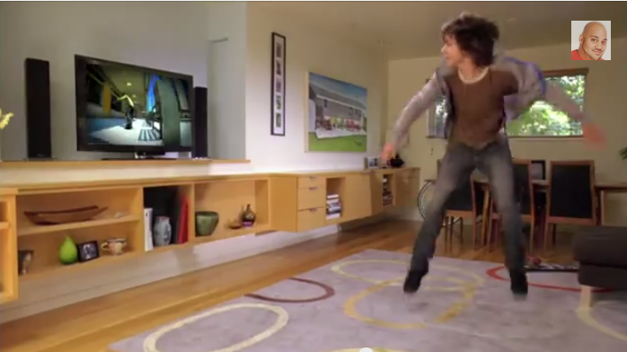
Natal Xbox 360 Announcement
Keywords
Xbox
Input
Full Body Gaming
Sensor
Output:
TV
Technology:
Remote
Movement

Slide 2
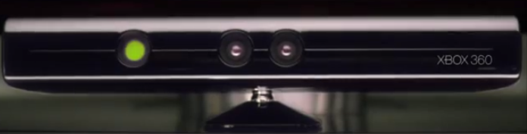

Natal Xbox 360 Announcement
Description:
Controller-free gaming means full body play. Kinect responds to how you move. So if you have to jump ,then jump. If you have to move, then move. When Once you wave your hand it automatically active the sensor and Kinect will be able to recognize by any movement you and access your as AVATAR.
Links:
http://www.youtube.com/watch?v=p2qlHoxPioM/

