Slide 1
Displaying
Group 6
Suraj Bhattarai
Mohammad Haque
Rudolf Uivari

Slide 2
Displaying
We don’t just talk about display but we try talk about everything that we can display.
Basic method of displaying are:
  Multiscreen.
  Texture mapping on plane surface.
  3D Projection mapping.

Slide 3
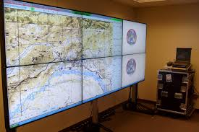
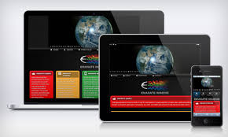
Multiscreen
Two or many screen.
A Multiscreen setup allows you to partition and display your content on several monitors or projection.
Helps to increase the productivity.

Slide 4
MultiScreen in VVV
vvvv is suitable to control any amount of client computers from a single server with a technique called “Boygrouping".Boygrouping lightens the effort involved in creating multi-screen systems or seamless multi-projection setups.

Slide 5
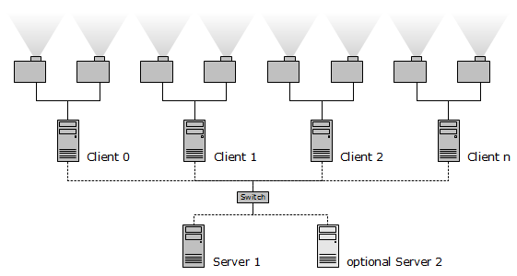
Boygrouping
"Boygrouping," allows you to replace one single object on the server with a group of Hardware Setup.
    Dedicated server pc, no of client pcs connected to ethernet.

Slide 6
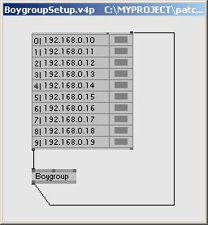
MultiScreen( Basic nodes
EX9 (comes with the addon pack in vvvv/multiscreening
S and R node (Server and client respectively).
Boygrouping patching

Slide 7
Boygroup
Clients and server
Connect through ethernet .
Directory Structure.
Preparation of clients
Boygroup patching.

Slide 8
Websites
https://vimeo.com/57452403
http://vvvv.org/documentation/boygrouping-basics

Slide 9
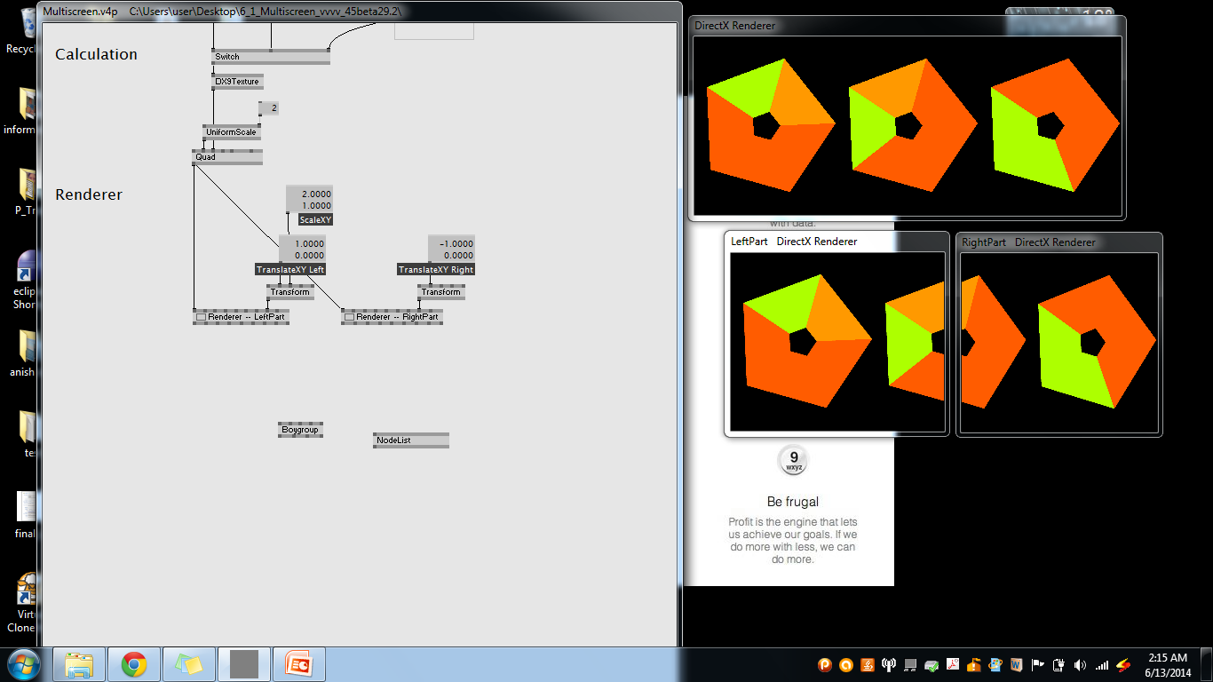

Slide 10
Texture mapping on plane surfaces
What is Texture?
2 and 3 dimensional element
Perceived surface quality
http://en.wikipedia.org/wiki/Texture_(visual_arts)

Slide 11
Texture Mapping
Can model the micro-geometry, material property
Increase the visual effect of a scene
Clever way to add surface details
graphics use texture mapping

Slide 12
Advantages
High quality Images
Speed up Rendering

Slide 13
Disadvantages
Rounding Error
Viewing Properties

Slide 14
Texture Mapping
Three types of mapping
Texture mapping
- Uses images to fill inside of polygons
Environment(reflection mapping)
- Uses a picture of environment for texture maps
Bump mapping
- Emulates altering normal vectors during rendering process

Slide 15
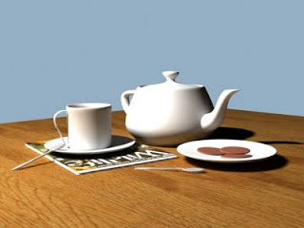
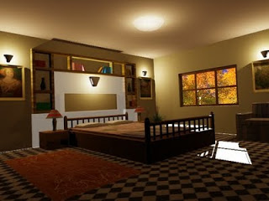
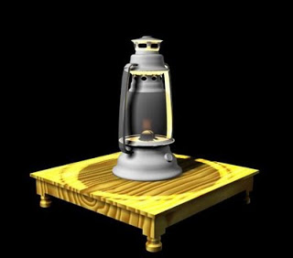
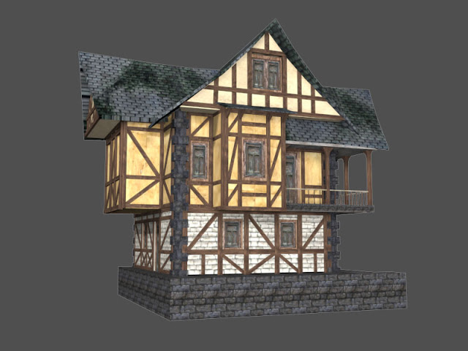
Texture Mapping
Can you do this?

Slide 16

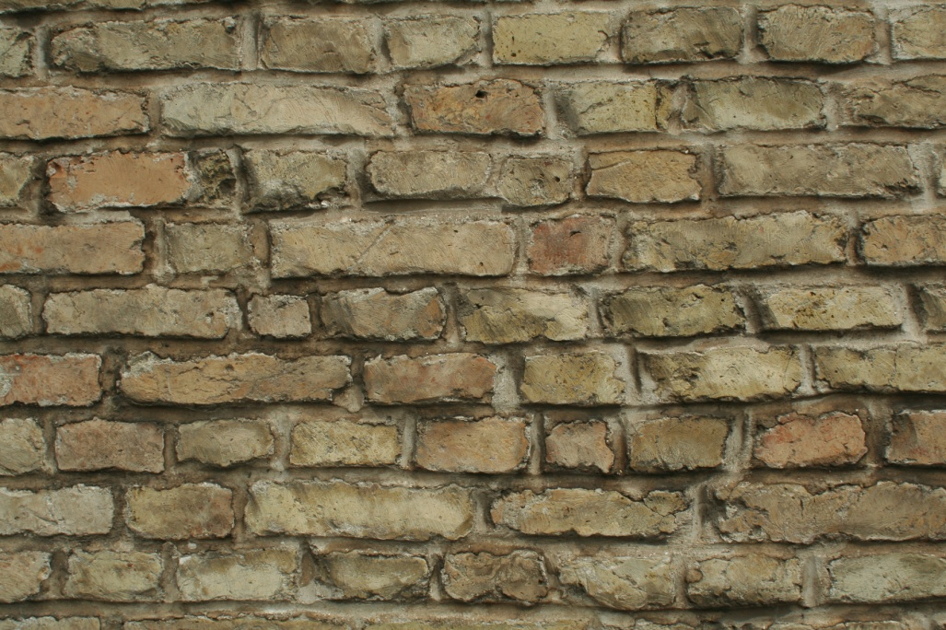
Texture mapping on plane surfaces
http://en.wikipedia.org/wiki/Texture_(visual_arts)

Slide 17
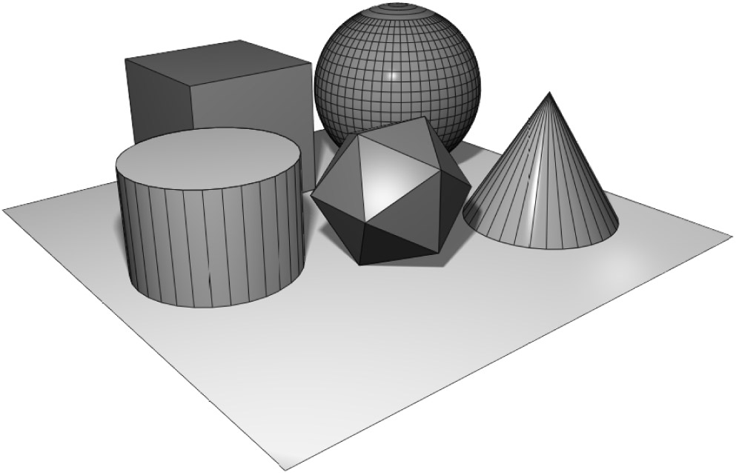
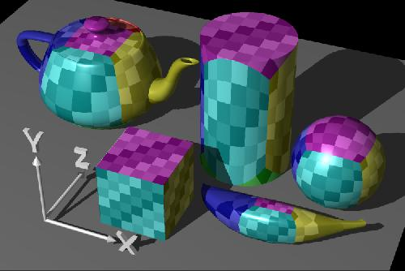
Texture Mapping
Geometric Model Texture mapped model

Slide 18
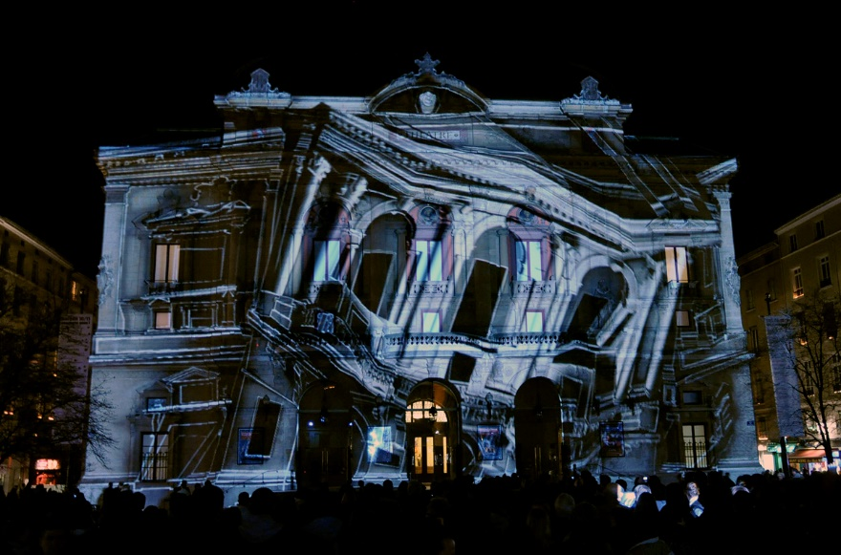
3D Projection Mapping
Introduction
History
Setup
VVVV
Video Example
http://wizardstudiosglobal.com/projection-mapping/

Slide 19
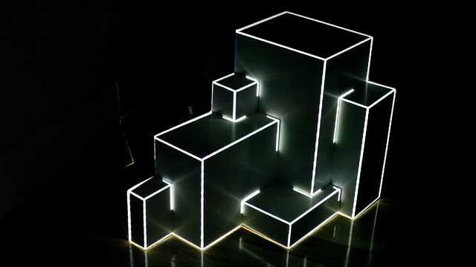
3D Projection Mapping
Introduction
Projection Mapping is used to create 3D Illusions on, mostly unregularly shaped, objects
This objects differ from small installations to complex industrial buildings
Mostly used for special occasions, festivals, openings, advertisements etc.
Visualization are based on different inputs: mainly sound and movement sensors

Slide 20
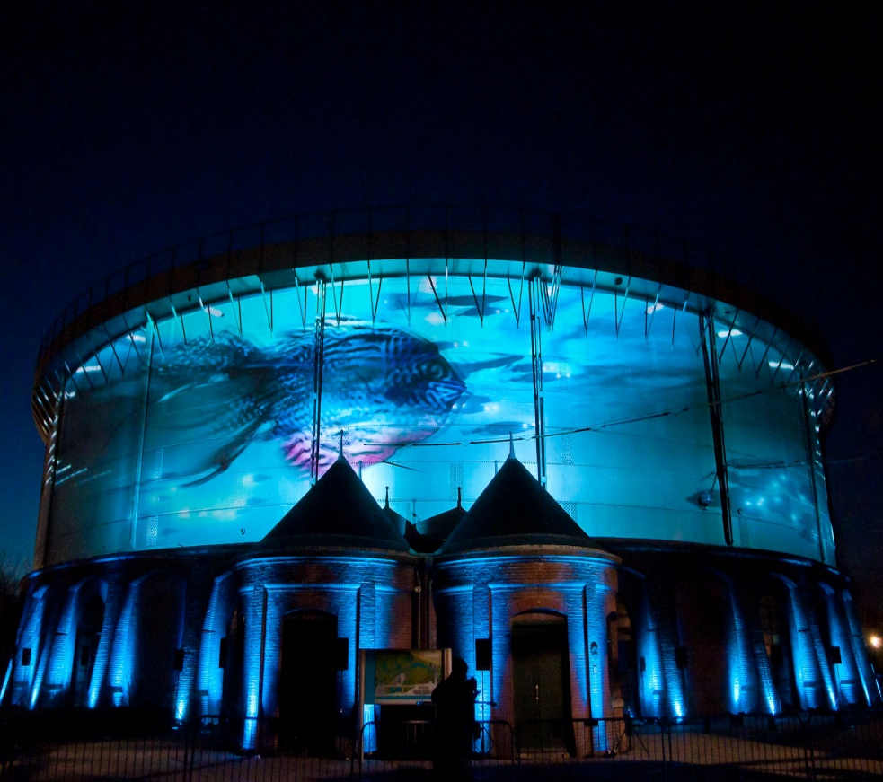
3D Projection Mapping
1. Introduction
Requirements:
  PC
  Beamer (at least one)
  Software (vvvv; vj-software etc.)
Additional requirements:
  Kinect, different Sensors
  Music Instruments (Midi Controller)
---

Slide 21
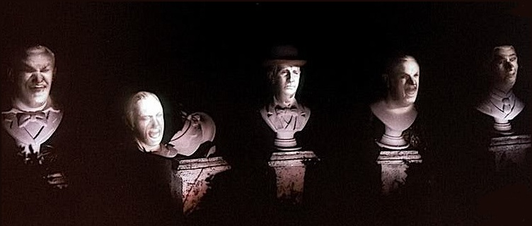
3D Projection Mapping
2. History
One of the first projections on non-flat surfaces is from 1969
Disney used the technique for some optical illusions
  for the opening of the Haunted Mansion ride in Disneyland
Singers were recorded and
the footage was projected
on the busts of their faces
http://projection-mapping.org/the-history-of-projection-mapping/

Slide 22
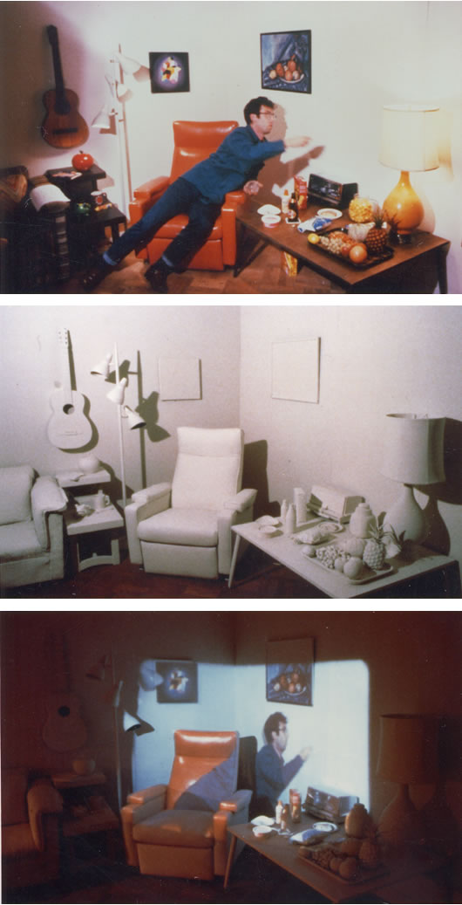
3D Projection Mapping
2. History
Another projection example of the 80s is from Michael Naimark
He recorded a room with two performers
The room was painted completely white
A projector displayed the recorded content
http://www.naimark.net/projects/displacements.html

Slide 23

3D Projection Mapping
2. History
http://projection-mapping.org/the-history-of-projection-mapping/

Slide 24
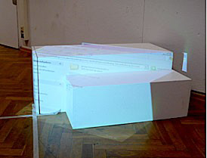
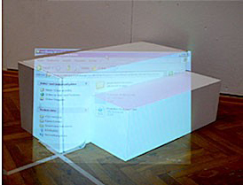
3D Projection Mapping
3. Setup
The main difficult in the beginning, is to find the right viewing position
The projection will look undistorted only from the view of the projector
So the projection needs to be adjusted to fit the real world shapes
http://vvvv.org/documentation/how-to-project-on-3d-geometry

Slide 25
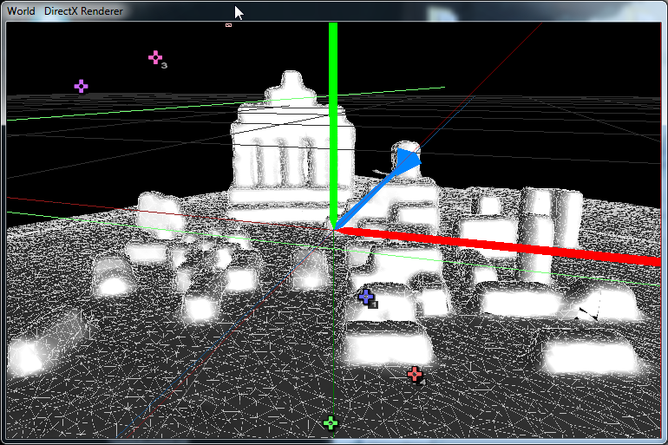
3D Projection Mapping
3. Setup
As next step, the environment should be rebuild as a virtual replica
It can be made either in vvvv with simple geometries or in other 3D software (e.g Blender)
This example was created with ReconstructMe (SDK for free available)
http://vvvv.org/contribution/vvvv.tutorials.mapping.3d

Slide 26
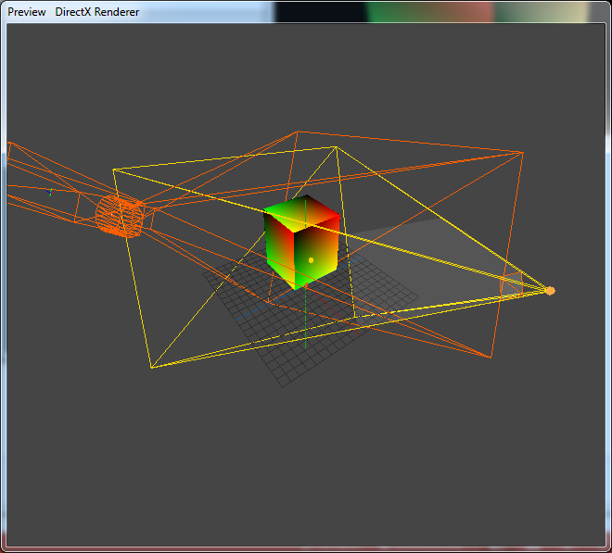
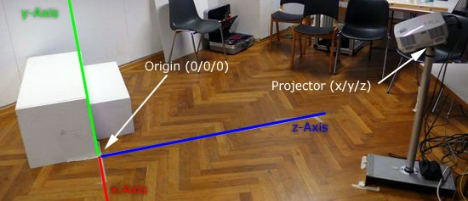
3D Projection Mapping
3. Setup
For the best result, the real coordinates must be implemented in the virtual scene with regarding to the projectors position, orientation and lens-characteristics
http://vvvv.org/documentation/how-to-project-on-3d-geometry

Slide 27
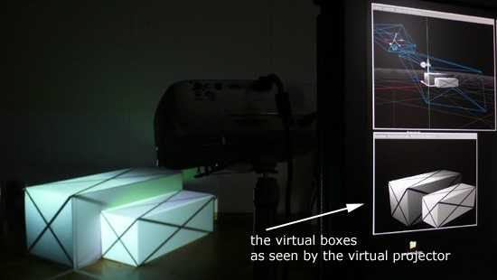
3D Projection Mapping
3. Setup
As last step, a texture or video can be mapped on the objects
Further, any kind of combinations with other devices, sensors, music are
possible
http://vvvv.org/documentation/how-to-project-on-3d-geometry

Slide 28
3D Projection Mapping
5. Video Example
http://www.youtube.com/watch?v=UJ7E7uEZN00&feature=kp
http://www.youtube.com/watch?v=4iGNTegpLZI#t=137
---

