Slide 1
Sketching user experience
Video Envisionment
- Seenuvasan Ramamurthy &
Daniel Klinkhammer as “Advisor”

Slide 2
DESIGN is not HOW IT LOOKS,
  but it’s HOW IT WORKS

Slide 3
Why Sketching ???
“Sketching is the best way to explore new ideas for designing better solutions”
It’s the quickest and low cost method of creating design solutions from ideas in mind. It also requires only a pencil and paper.

Slide 4
What is it ?
“ Sketch is an outline drawing of any idea which serves later for refinement of ideas but not for later use”
The value of a sketch depends on the DISPOSABILITY of a sketch.
VALUE = DISPOSABILITY

Slide 5
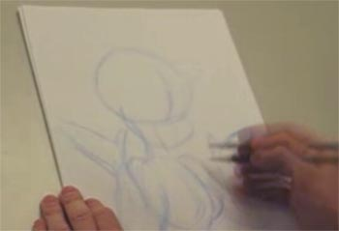
Sketching process : Cartoonist way
#1 : Sketch the outlines first in the lowest possible fidelity

Slide 6
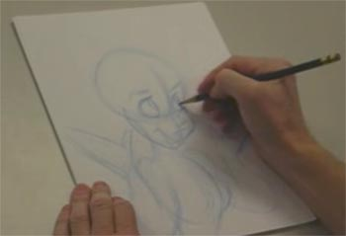
Sketching process : Cartoonist way
#2: Refine the important stuff next, save the unimportant stuff for last.

Slide 7
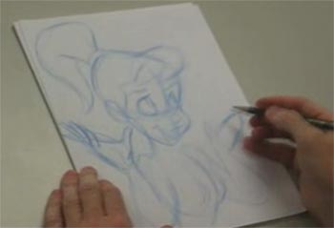
Sketching process : Cartoonist way
#3: Never stop moving the pencil.

Slide 8
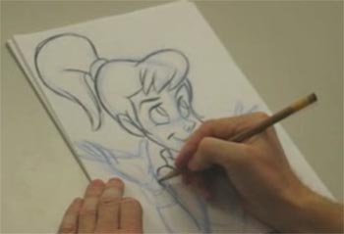
Sketching process : Cartoonist way
#4 : It's easier to erase thin, light lines than it is dark, heavy ones.

Slide 9
Sketching process : Cartoonist way

Slide 10
Cartoonist way: Related to Design?
#1 : Sketch the outlines first in the lowest possible fidelity
- Start you ideas with low cost methods
#2 : Refine the important stuff first, save the unimportant stuff for last.
- Look out important possibilities at first
#3 : Never stop moving the pencil.
- Explore till you find best design
#4 : It's easier to erase thin, light lines than it is dark, heavy ones.
- Easier to correct design than code
Refernce : http://viget.com/inspire/5-lessons-from-a-cartoonist-applied-to-the-website-creation-process

Slide 11
Why Video in sketching ?
Video captures ideal behaviour over time.
Video captures what document only describes.
Video captures gestural affordances.
Video captures stakeholder attention.

Slide 12
The process : Video Envisionment
Plan the shoot
Set-up the shoot
Shoot the scenario
Evaluate and edit

Slide 13
Video : Plan the shoot
Create the complete story board at first.
Find the sketched out flow of the each and every screen
Interactions and the devices used are to be decided
Have the location setup and the pre-visualize the angle too to avoid repeated iterations in video making
Get idea about the voice over, the mime, to be synchronized with the video

Slide 14
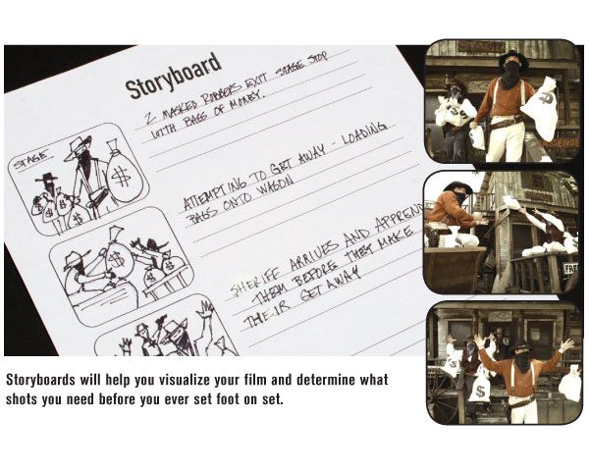
Video : Plan the shoot

Slide 15
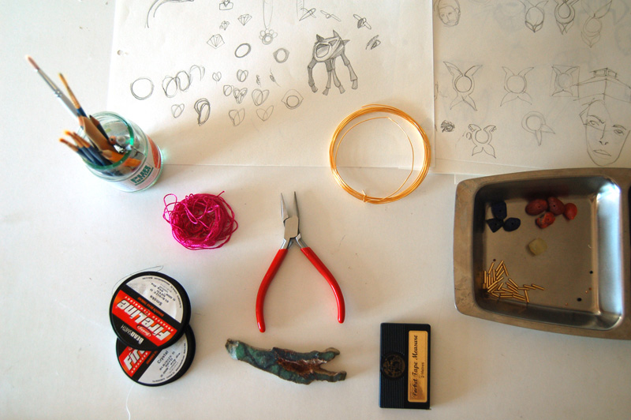
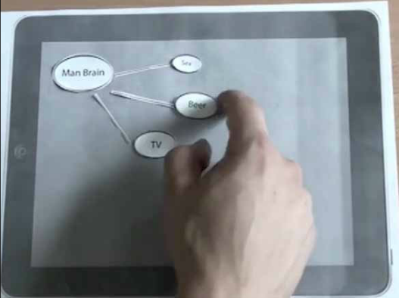
Video : Set-up the shoot
Draw necessary screens at size, build devices at proportional level to the screens.
Setup materials on location before starting the shoot.
It is also advisable to check the lighting and the actual camera angles.

Slide 16
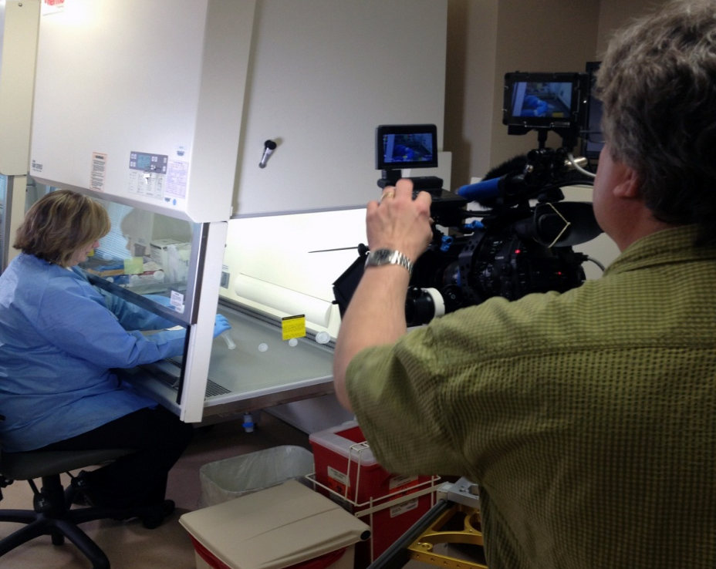
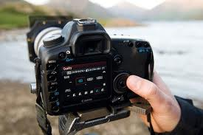
Video : Shoot the scenario
Use a tripod while shooting any kind of scene.
Adjusting details and editing in the camera will avoid handful of tasks later.
We also need to shoot duplicate shots which are critical at later stages.

Slide 17
Video : Evaluate and edit
Watch out all the takes, write up notes to connect with the story board.
It may also require some re-shoots for some of the necessary takes.
Load best takes into the editing program to make your sketching shot as a video.
Iterations during the evaluation will avoid errors made in the environment setup

Slide 18
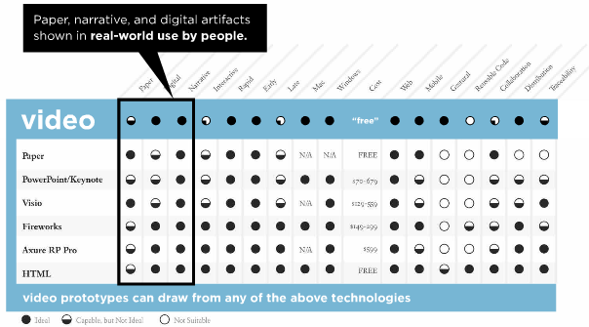
Video prototype advantages
Reference: “Prototyping - The practitioner’s guide“, Todd Zaki Warfel

Slide 19
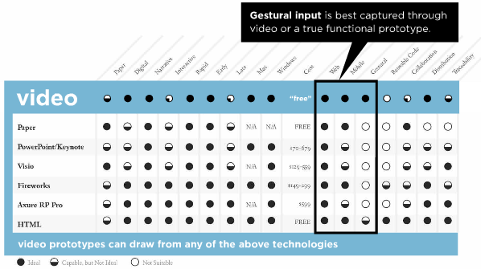
Video prototype advantages
Reference: “Prototyping - The practitioner’s guide“, Todd Zaki Warfel

Slide 20
“IF YOU WANT TO HIT BY A CAR GO AND PLAY IN TRAFFIC, NOT IN CORNFIELD”
- Bill Buxton

Slide 21
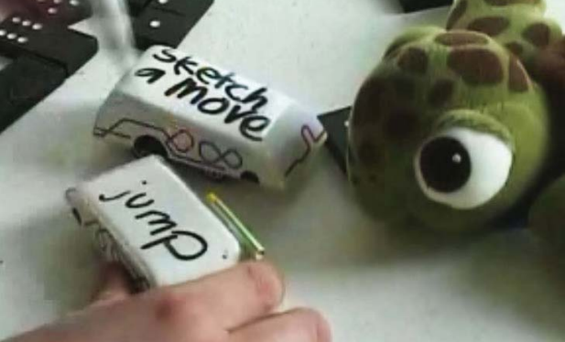
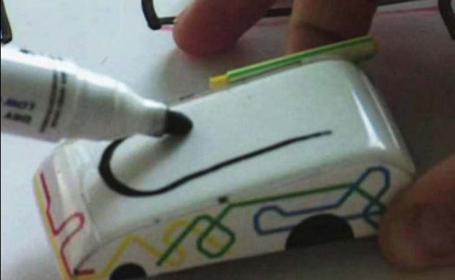
Sketch a Move
A concept by Anab and Luise.
What is it ??
They have designed the mock-up using a toy car which says about the functionality of the working rather than functionality of the actual system.
Reference : Sketching user experiences, “Bill Buxton”

Slide 22
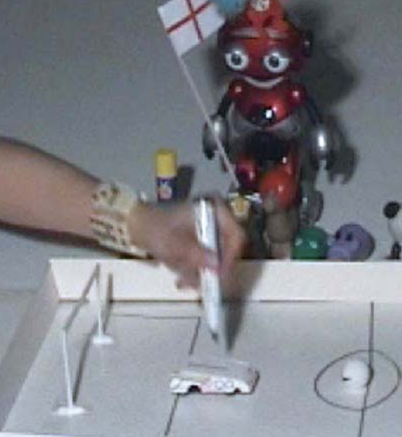
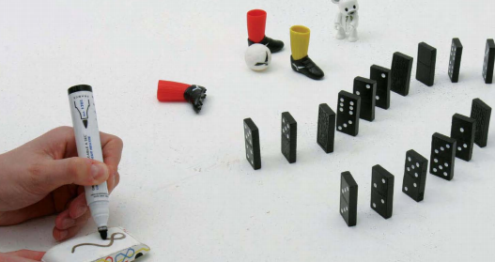
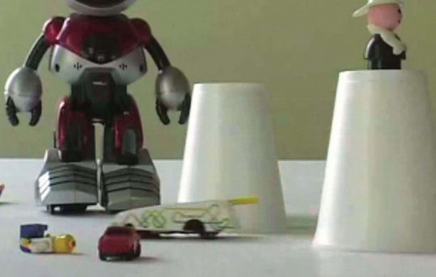
Sketch a Move
They had all the imaginable details flourished in the mock-up which took their sketch to an exceptional level.
Reference : Sketching user experiences, “Bill Buxton”

Slide 23
Sketch a Move
Their sketches were called sketches because:
Sketches had distinct vocabulary that differentiated from finished renderings.
The resolution or style of the rendering suggested a degree of refinement or completion that exceeded the actual state of development or thinking of the concept.
The other criteria observed from their sketches were :
Quick
Timely
Inexpensive
Disposable
Reference : Sketching user experiences, “Bill Buxton”

Slide 24
Shoot the MIME
How can we create an video animation by design to show the working of a product ?
Make simple design sketched of your system's interface in action. No users to be included.
Playback animation on intended target display
Mime along the animation which exactly synchronizes with the animation
Video tape the Animation + Mime
Reference : Sketching user experiences, “Bill Buxton”

Slide 25
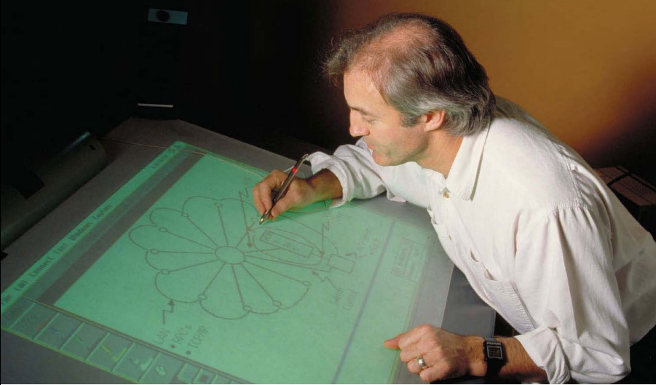
Shoot the MIME
We can see the use of the real environment to Demonstrate the design concept which works well in exploring more in the design.
Reference : Sketching user experiences, “Bill Buxton”

Slide 26
Shoot the MIME - Learnings
We have to use less real things in sketches which is easier to suspend one's disbelief.
Creating animations as mock-ups rather than real experience makes user to focus on interaction and context rather than actual product.
Playing the animation or mock-up simulation on a real system's environment will certainly have an impact about the interactions in the system.
Reference : Sketching user experiences, “Bill Buxton”

Slide 27
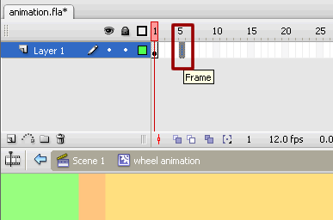
Keyframes and Tweening
Keyframes and Tweening are the two most basic capabilities in all the animation tools to create motion paths to present our interactions more appropriately.
Keyframes: Any frame in an animation sequence which consists of objects as well as their properties.
Ex. Keyframe from Adobe flash

Slide 28
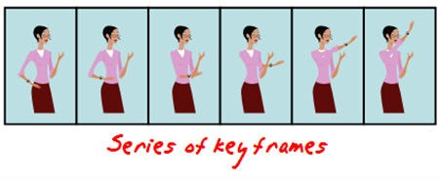
Keyframes
Using a series of key frames, the tweening is created which encompasses all these keyframes into a single motion animation.

Slide 29
Tweening
Process of generating the frames between two key frames.
Tweening helps in creating the interaction as a animation using the scenes created in the keyframes.

Slide 30
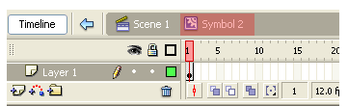
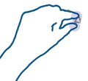
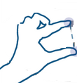
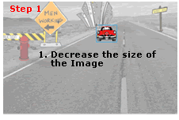
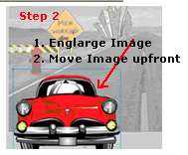

Keyframes & Tweening
?

Slide 31
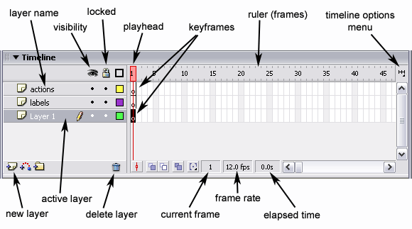
Timeline
We can see the timeline above naming the features which are used in an animation sequence.

Slide 32
Tools could be useful
Video Editing
  Adobe Flash
  Adobe Premiere Pro
3D modelling
  Google SketchUp
  Trimble 3D warehouse

Slide 33
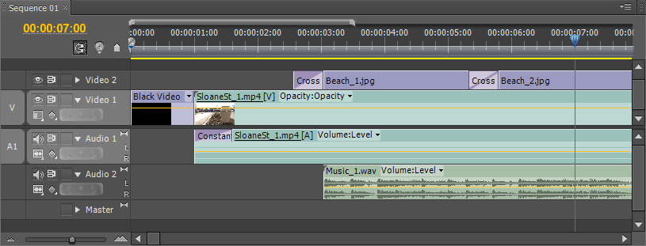
Video Editing
After the shooting of video, the editing tools are quite handy which makes the MIME and the SHOTS synchronized to give a contiguous interaction pattern which demonstrated the design of the idea(s).
Timeline view of Adobe Premiere Pro

Slide 34
3D modelling : Google SketchUp
BASIC 3D Sketching video:
http://www.youtube.com/watch?v=A_9gl3MNA10
The above video shows how to create basic 3D drawings to setup an environment which helps us to create the entire environment in 3D. This helps in creating mock-ups in complex environments.

Slide 35
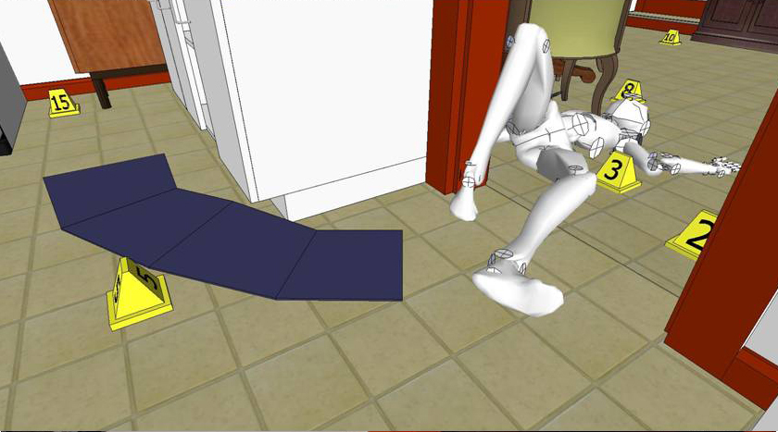
3D modelling
We have a crime scene below which shows how the exact environment can be created using a 3D modelling tool..

Slide 36
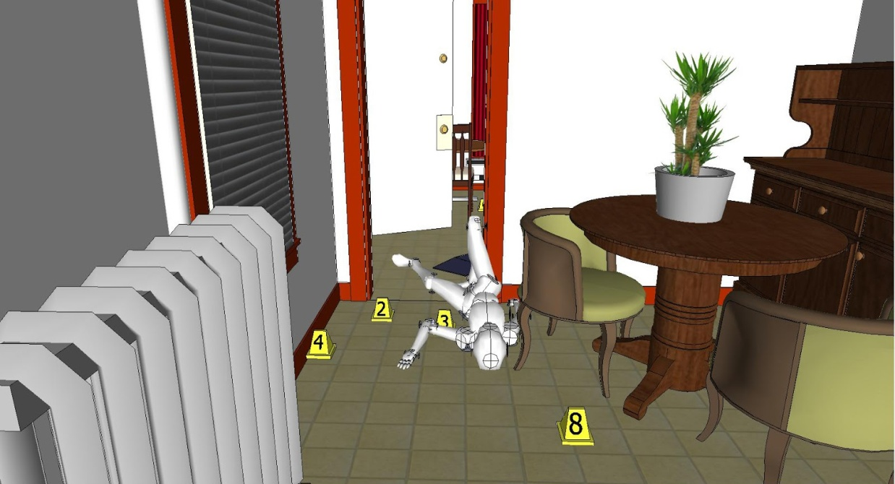
3D modelling
This helps us to reduce the cost and time required in setting up the environment to shoot.

Slide 37
A good example
The video that inspired me for video envisionment is
http://www.youtube.com/watch?v=9wQkLthhHKA
Though this video demonstrates the usability testing of a paper prototype, it perfectly narrates what the user feels about the user experience with his sketches.
Add-on to this video
I thought that the with the help of creating video like this, we can get more critics on the design and feedback from many users about the user experience of the system. I would recommend to combine questionnaire with the video to get the user actions which could be performed by users while watching the video. This kind of video will have both the user actions and critics in the design even though, it does not give you the real-experience.

Slide 38
Any questions??
Thank you

