Slide 1
PHIDGETS
Presented By:
Lokesh Vasipalli
Helna James Kuttickattu
Minh Huyen Do Thi
Emmanuel Nsambu

Slide 2
Overview
Introduction
Types of Sensors
How do the Sensors work?
Some Applications where they are used
Phidgets Connection
Demonstration with Phidgets

Slide 3
Introduction
Sensors are devices that detect input from the environment and respond accordingly.
The output of sensors is a signal that used for display or for further processing.
Examples of sensors: heat, sound, touch, light, motion sensors,… etc.

Slide 4
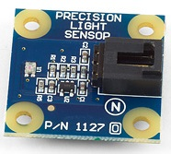
Types of sensors
Light Sensor
Types: Photo-conductive cell, photo-junction devices, etc
Light Sensor (photo-conductive cell)

Slide 5
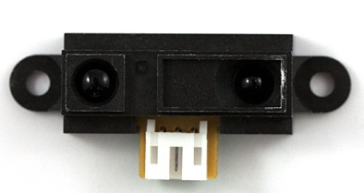
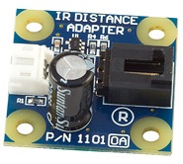
Types of sensors
Distance Sensor
Types: Infrared, ultrasonic sensors, etc
Distance Sensor (infrared)
Adapter

Slide 6
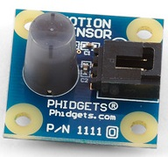
Types of sensors
Motion Sensor
Types:
Infrared, optics, radio frequency, etc
Motion Sensor (infrared)

Slide 7
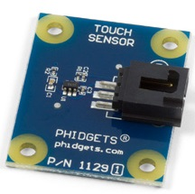
Types of sensors
Touch Sensor
Types: Capacitive and resistive touch sensors
Touch Sensor (capacitive)

Slide 8
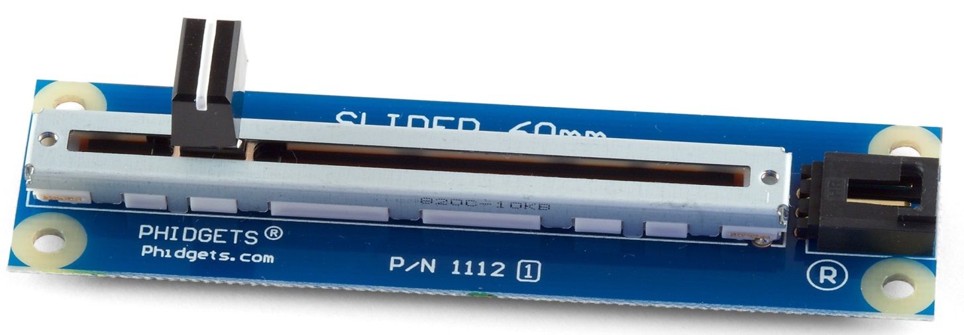
Types of sensors
Potentiometer
Types: Linear and rotary
Potentiometer (linear)

Slide 9
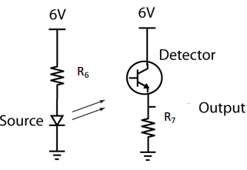
How do the Sensors work?
Light Sensor
  Completes the circuit when light is detected

Slide 10
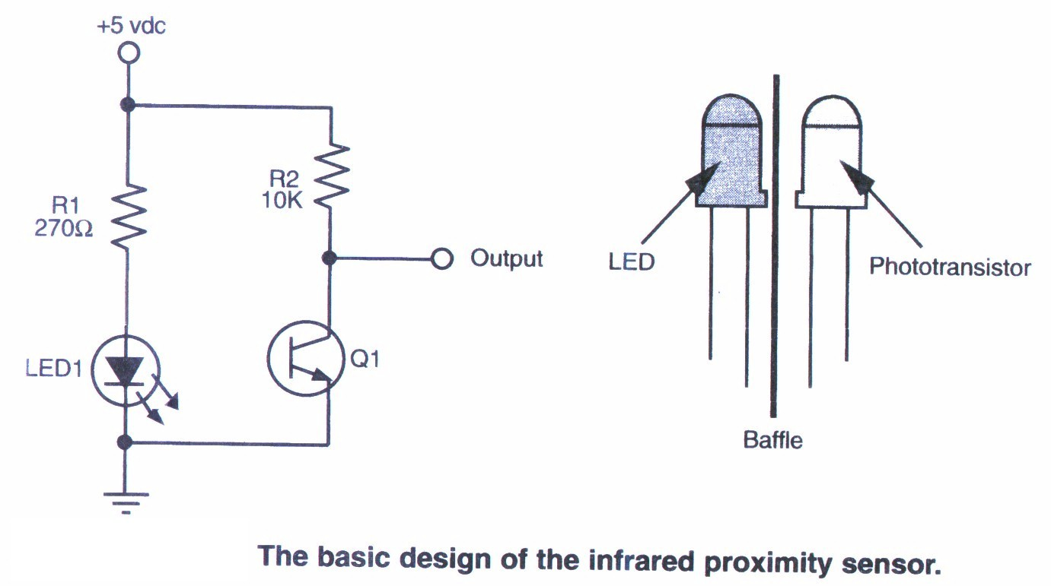
How do the Sensors work?
Distance Sensor
  Uses infrared to detect the distance from an object

Slide 11
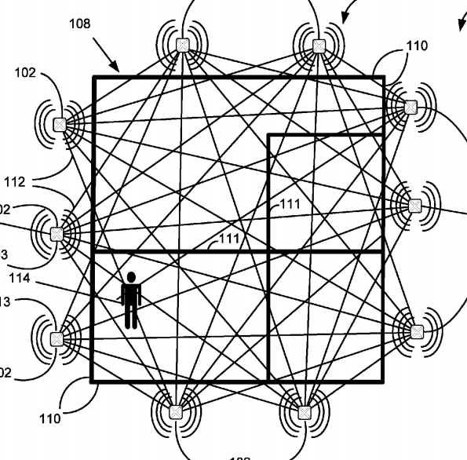
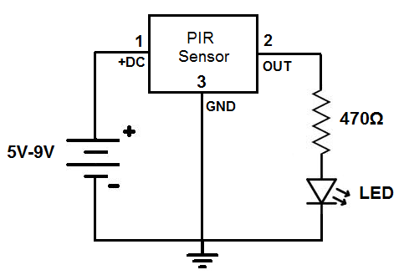
How do the Sensors work?
Motion Sensor
  PIR – Passive Infrared

Slide 12
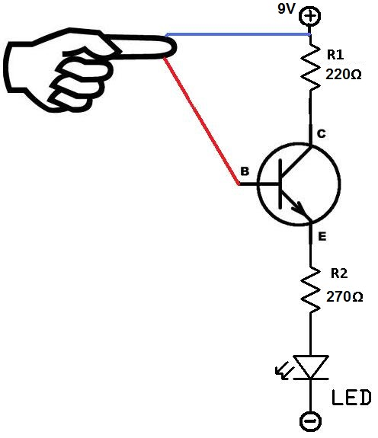
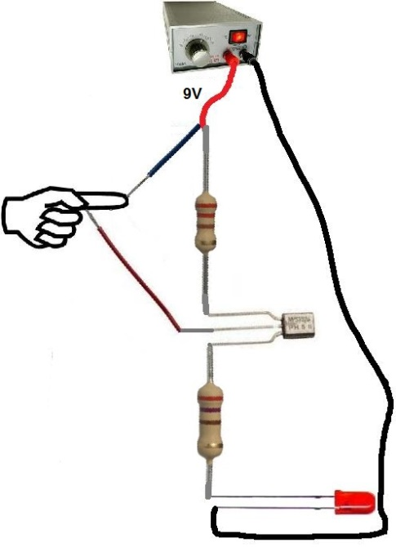
How do the Sensors work?
Touch Sensor
  electrode is placed behind a surface e.g glass, paper, etc
  touch increases capacitance and triggers the switch

Slide 13
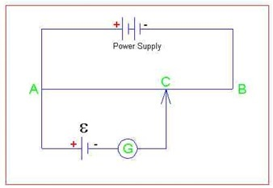
How do the Sensors work?
Potentiometer
  works as a voltage divider
  A,B – potentiometer
  C - sliding control
  G - galvanometer

Slide 14
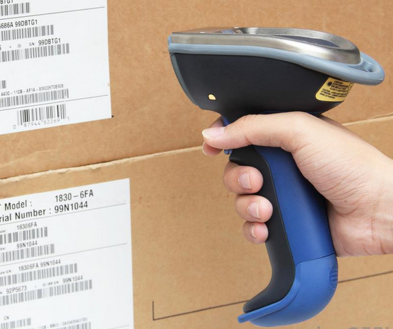
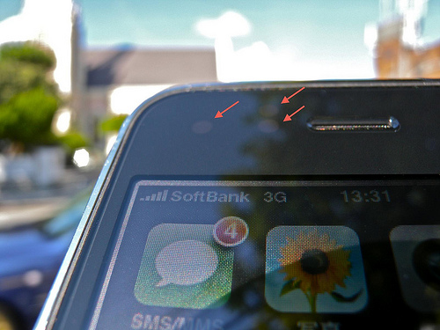
Some Applications where they are used
Light Sensor
Bar code scanner
Light sensor in a smartphone

Slide 15
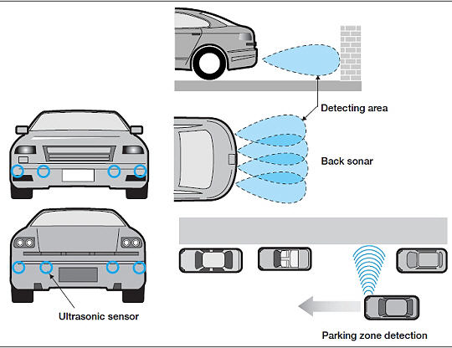
Some Applications where they are used
Distance Sensor

Slide 16
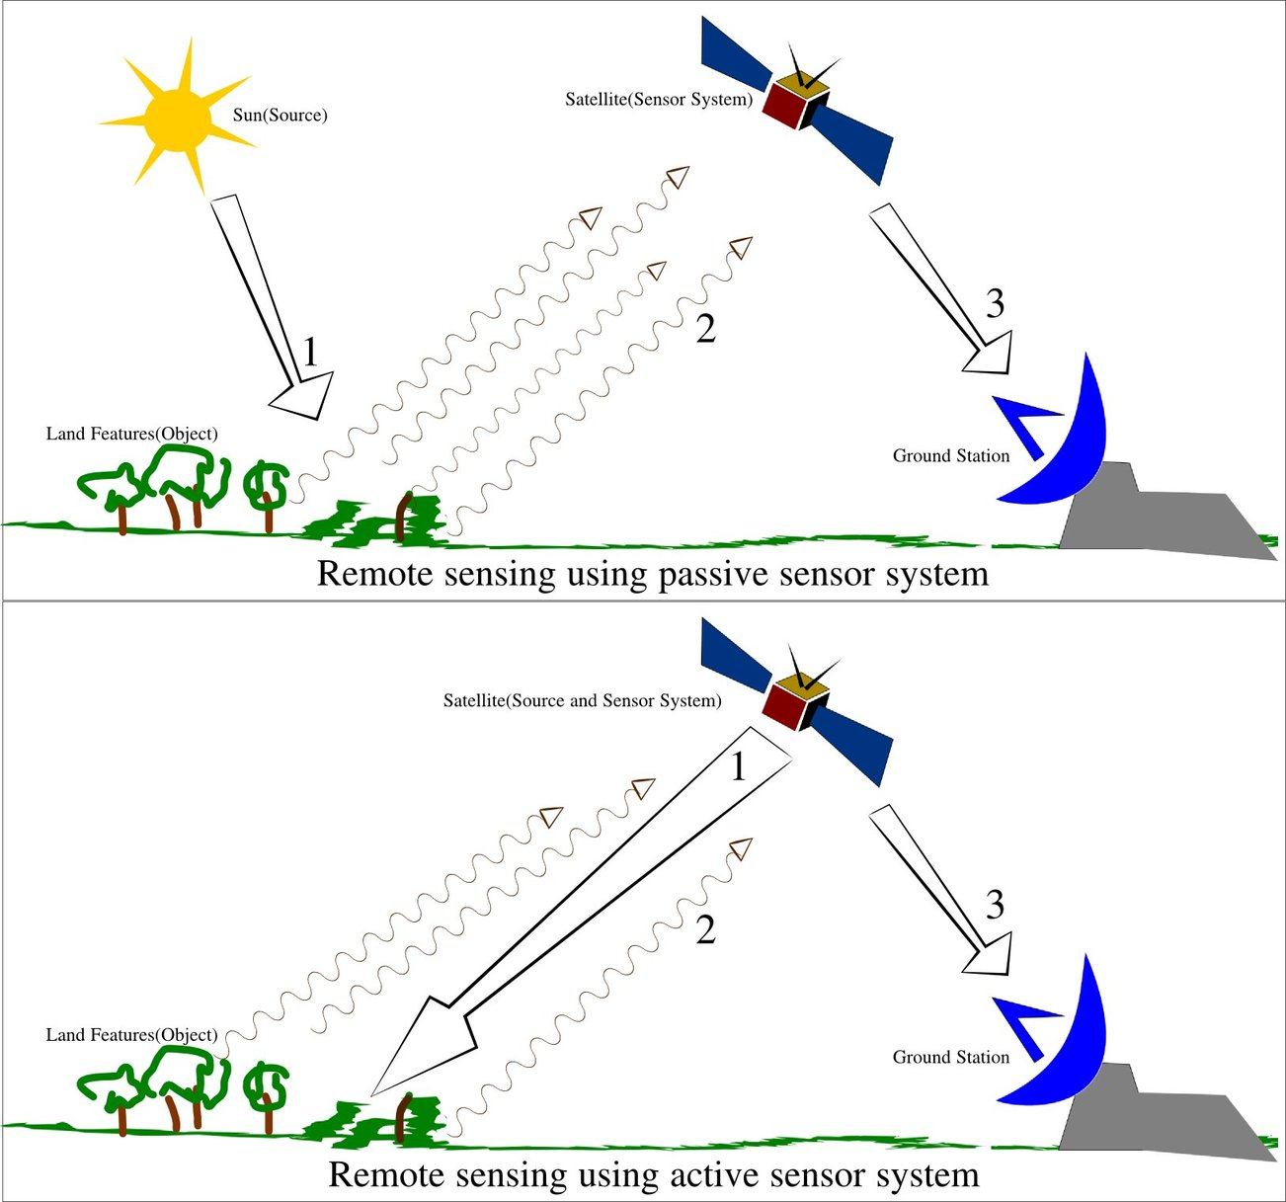
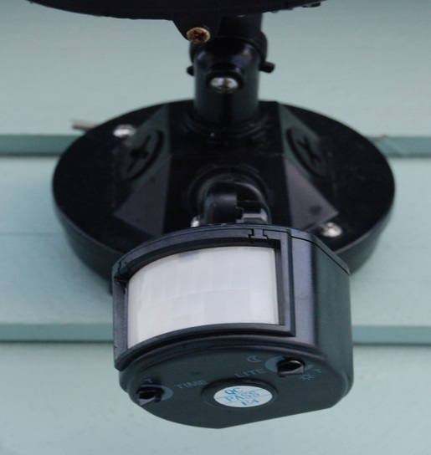
Some Applications where they are used
Motion Sensor
Burglary alarm

Slide 17
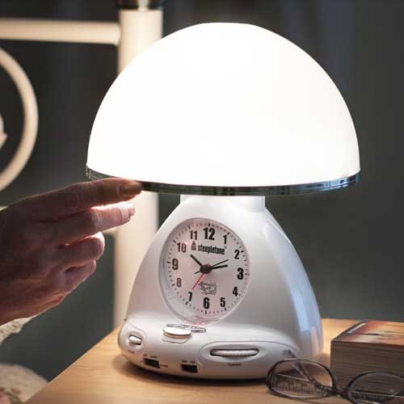

Some Applications where they are used
Touch Sensor
Smartphone touch screen
Touch sensor in a lamp

Slide 18
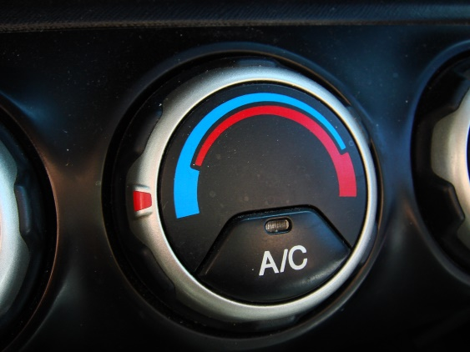
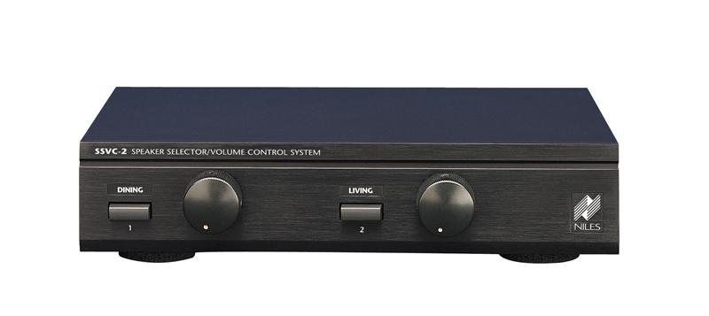
Some Applications where they are used
Potentiometer
Volume control
Air conditioning system in a car

Slide 19
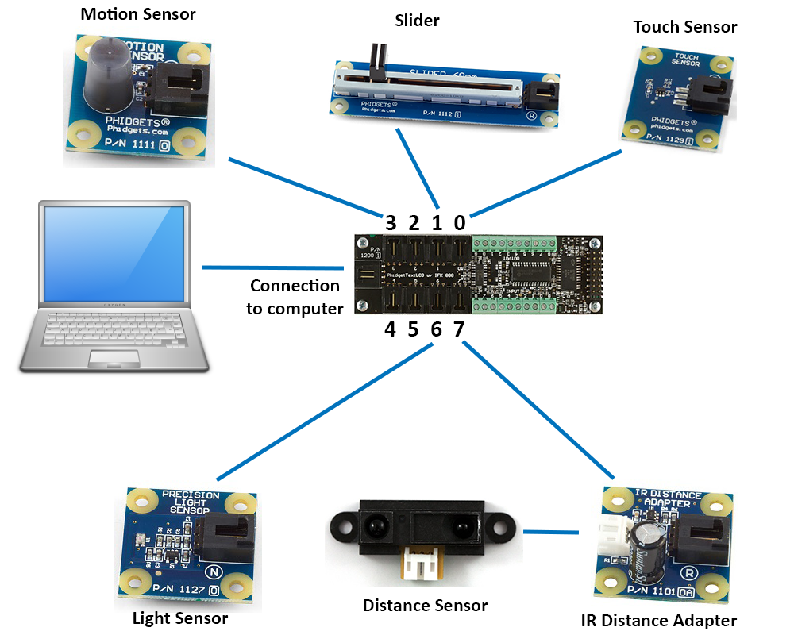
Phidgets Connection

Slide 20

Demonstration with Phidgets
Let the fun begin!!!

