Slide 1
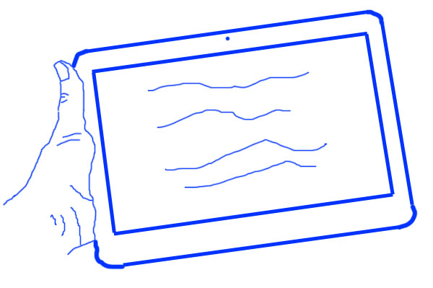
Sketching Basics
Ingo Hofmann
SS 2013

Slide 2
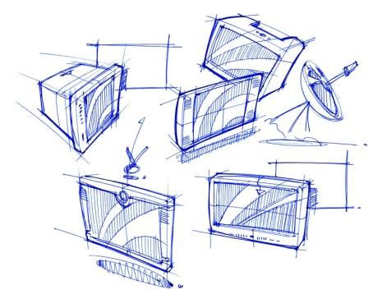
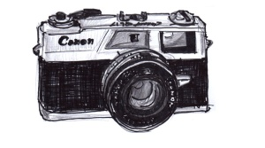
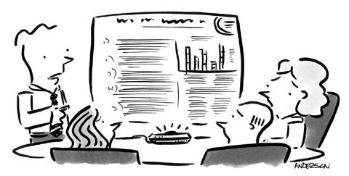
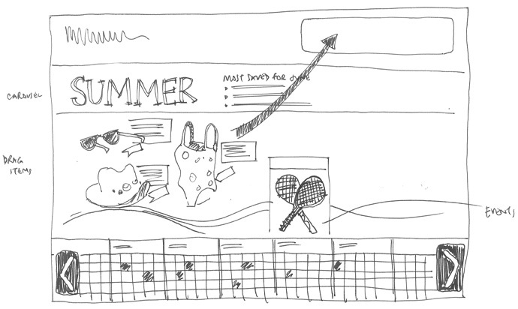
The Real World
Getting into mood
Sketching

Slide 3
The Real World
Getting into mood
Sketching

Slide 4
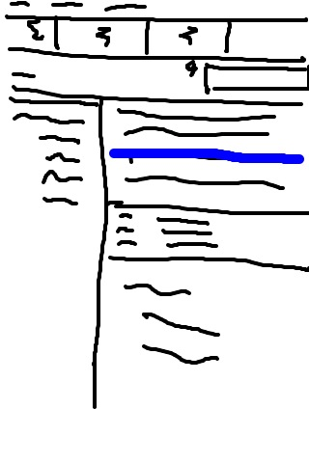
Scribble Sketching
How it works:
  Take paper & pencil
  Scribble within 30 seconds
Identify key features
Remember cool things

Slide 5
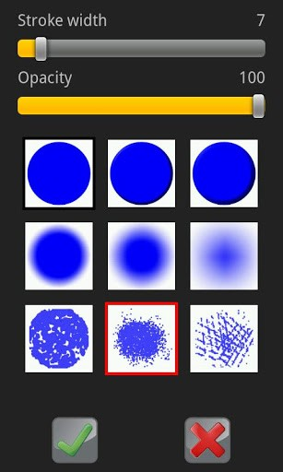
Scribble Sketching - Tools
iPad App: Scribble (Lite)
Android App: Draw and Share
Web Application:
http://www.zefrank.com/scribbler/
Microsoft OneNote

Slide 6
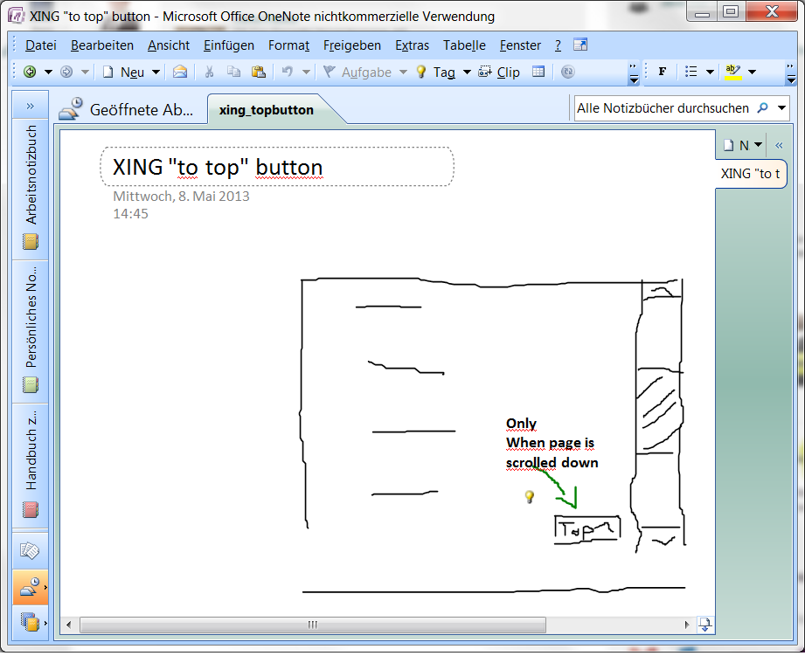
Scribble Sketching – OneNote Example

Slide 7

Sampling with cameras
Become a hunter and gatherer
Take pictures that
  Irritate
  Impress
  Inspire

Slide 8
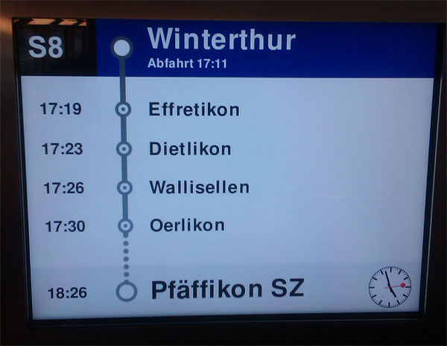
Sampling – Example 1

Slide 9
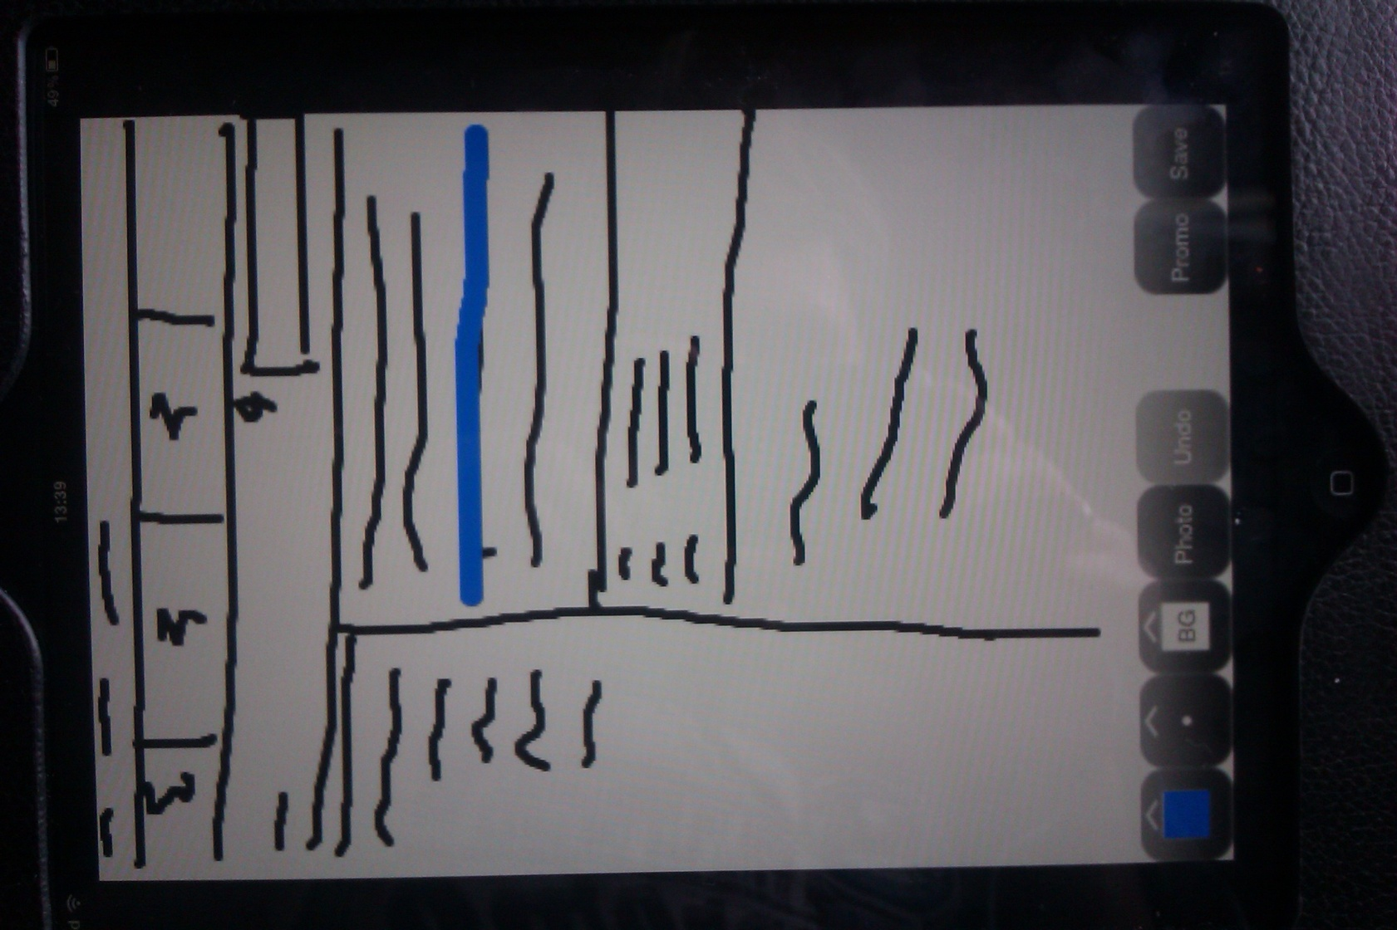
Sampling – Example 2

Slide 10
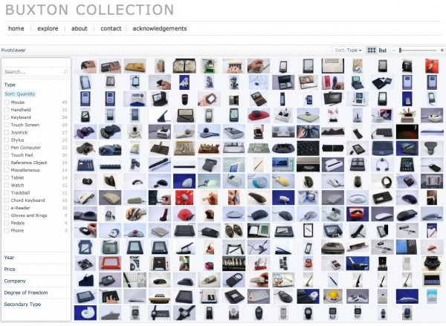
Building Collections
Archive your findings
Possible collections
  Digital Archive
  Shoe boxes
  or physical file folders
  Sketchbook
  Toyboxes / containers / cardbox boxes

Slide 11
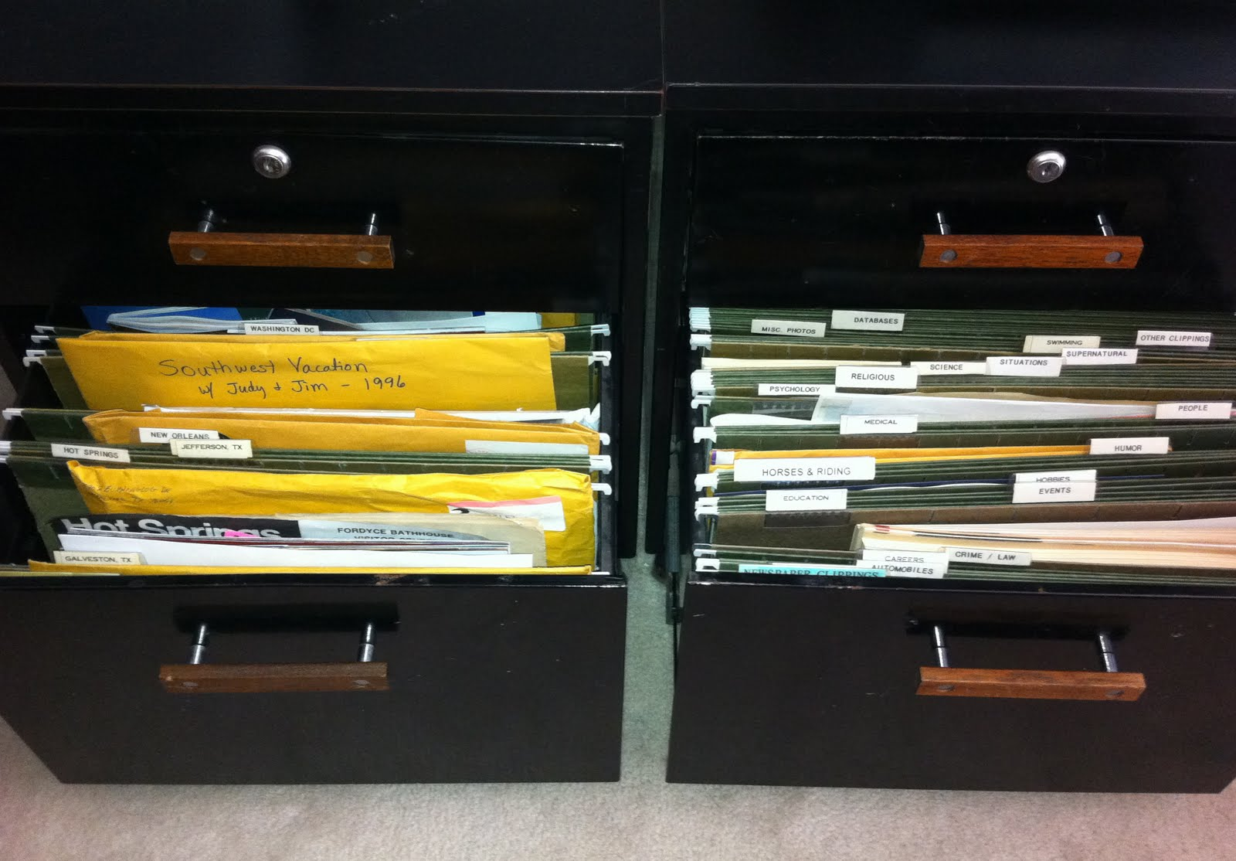
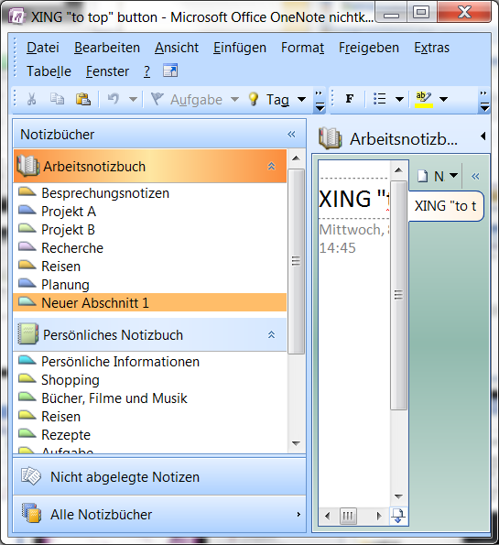
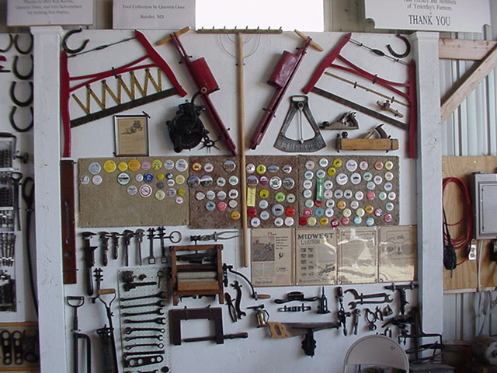
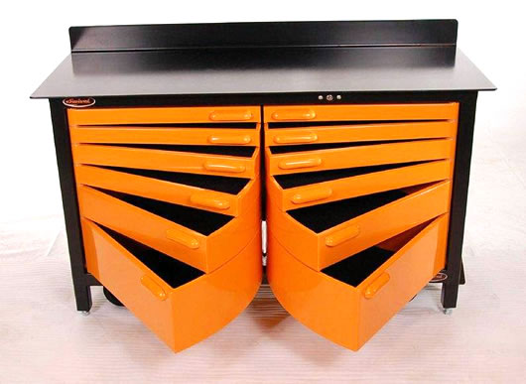
Collections - Examples

Slide 12
The Real World
Getting into mood
Sketching

Slide 13

Mood Boards
(Collaborative) Brain Storming
Define color scheme, shapes, „mood“
Present to stakeholders

Slide 14
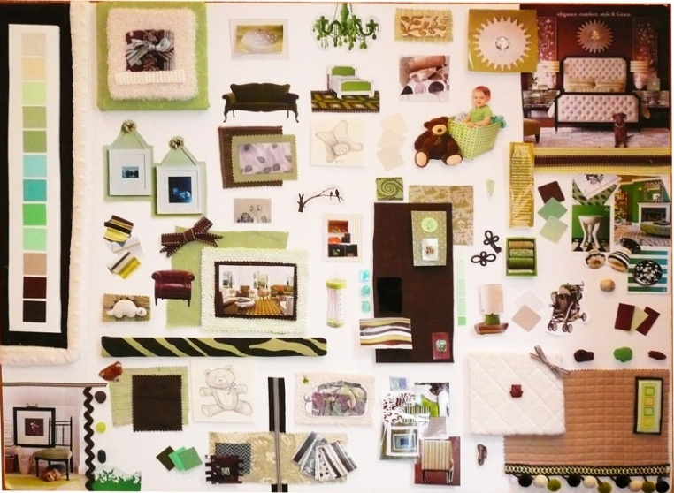
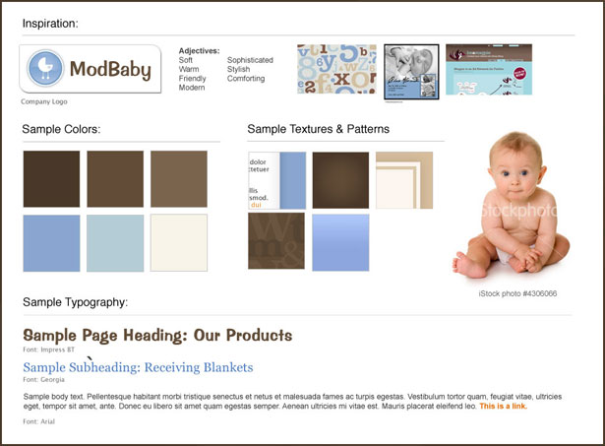
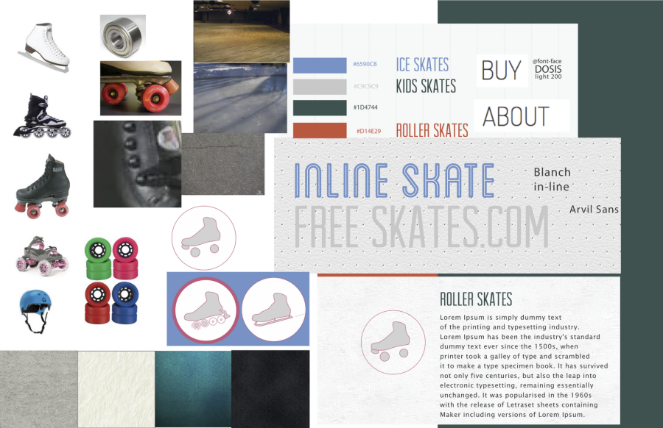
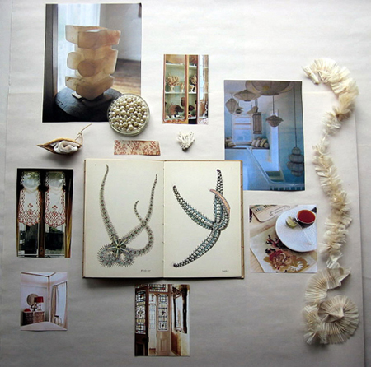
Mood Boards - Examples

Slide 15

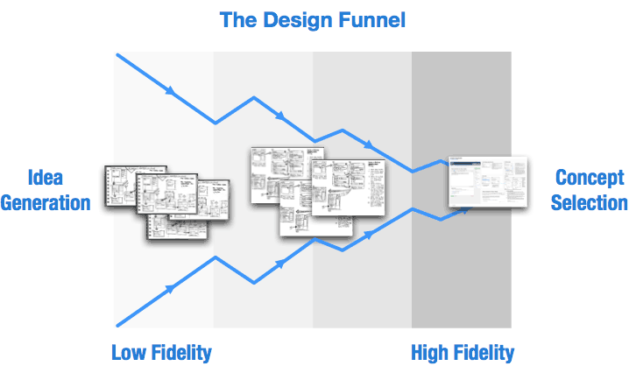
The Design Funnel
Iterative design process
Source: http://support.balsamiq.com/customer/portal/articles/107999-specifying-interaction-with-mockups

Slide 16
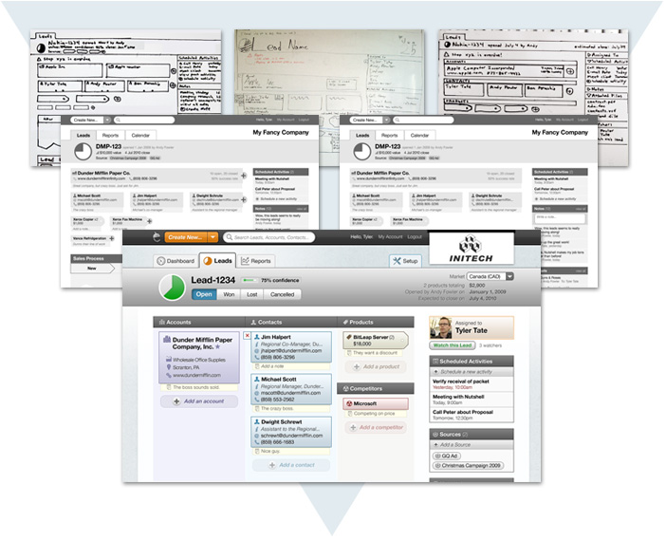
Design Funnel – Example

Slide 17
The Real World
Getting into mood
Sketching

Slide 18
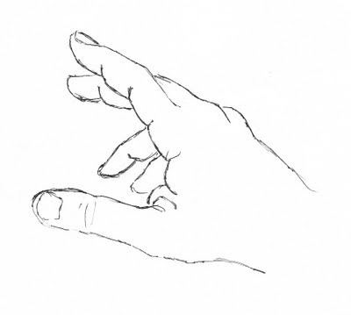
Draw what you see
Drawing for non-artists
Place existing drawing in front of you
Focus on lines
(direction, length, relation),
not on picture
Do not assume!

Slide 19
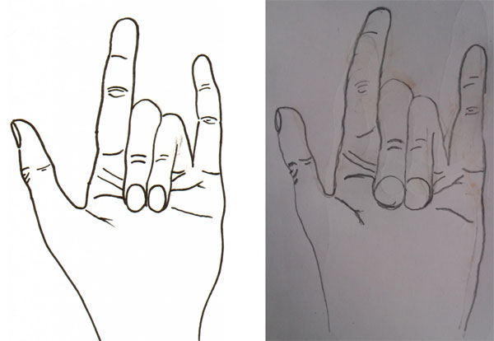
Draw what you see - Example

Slide 20
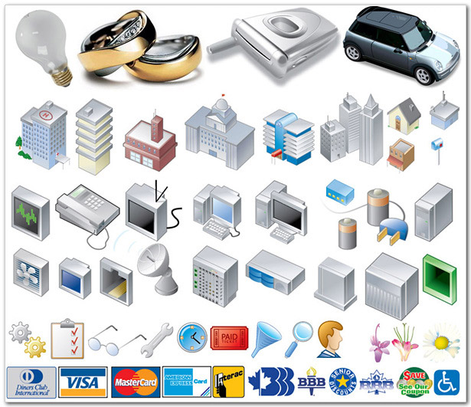
Building a library
Re-use common objects
Clipart images
Usage of drawing
primitives
(circles, rectangles,…)

Slide 21
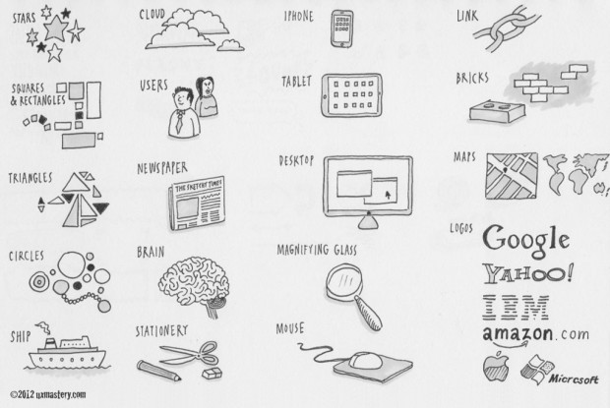
Library – common objects

Slide 22
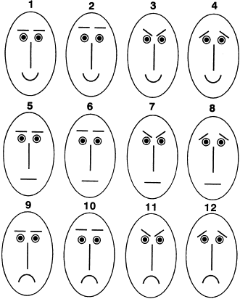
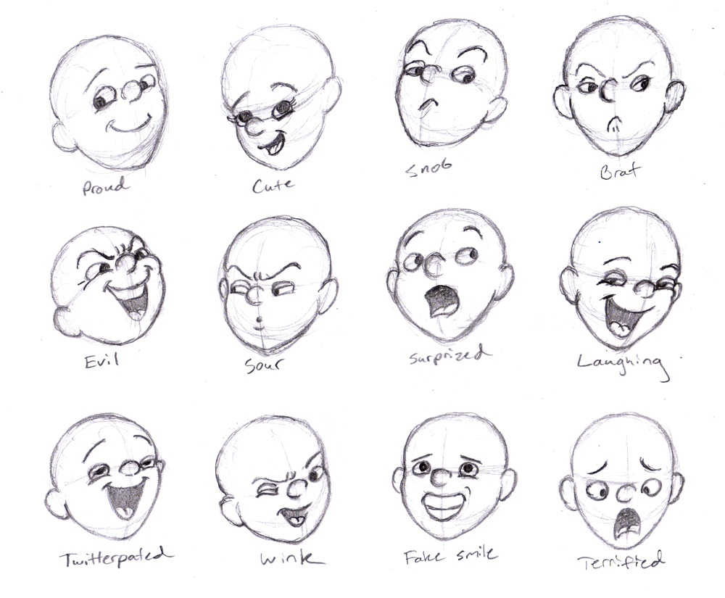
Library – emotions

Slide 23
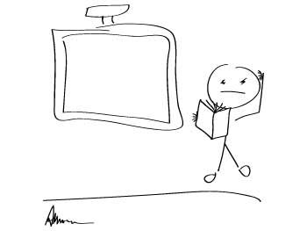
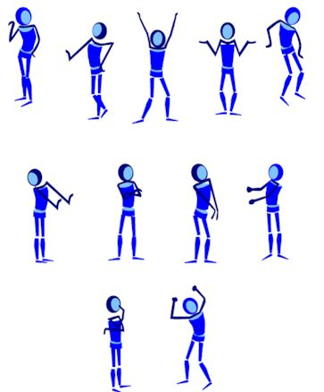
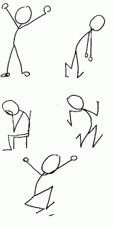
Library – bodies and emotions

Slide 24
Annotations and Arrows
Text notes with or w/out arrows
Arrows only: Indicate possible element movements
Describe basic interactions
Side notes: Questions / open issues to discuss

Slide 25
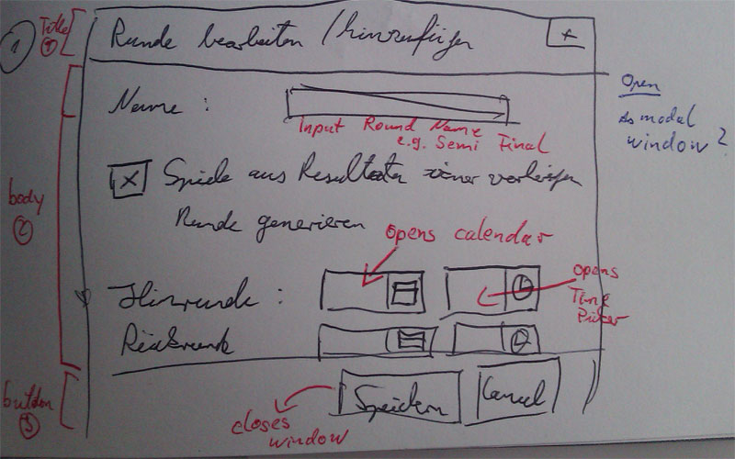
Annotations and Arrows - Example

Slide 26
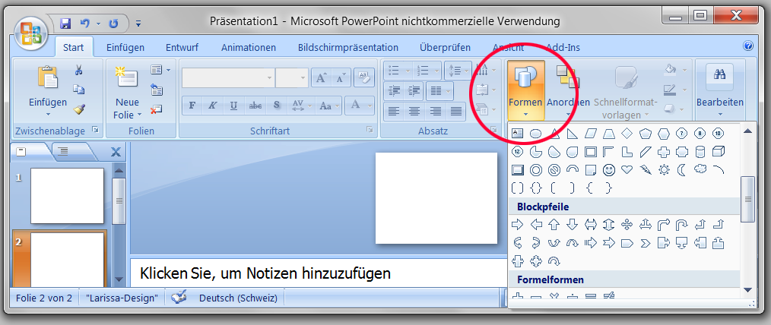
Sketching with PowerPoint
Slideware provides all basic elements
Supports interactions and notes
Allows easy manipulation / changes

Slide 27
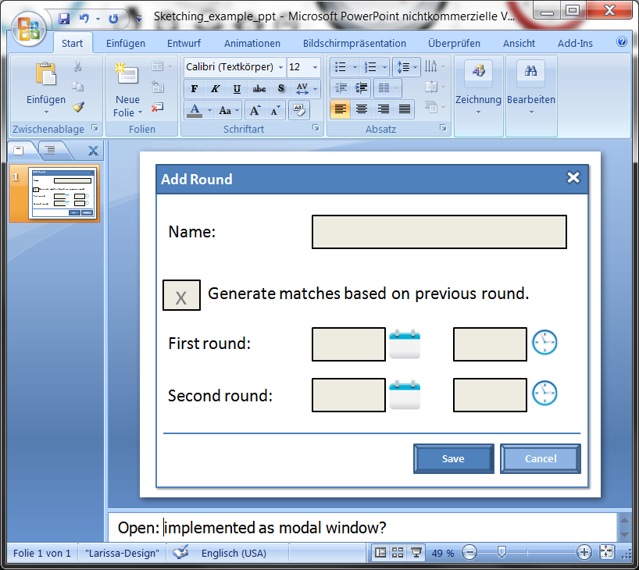
Sketching with PowerPoint - Example

Slide 28
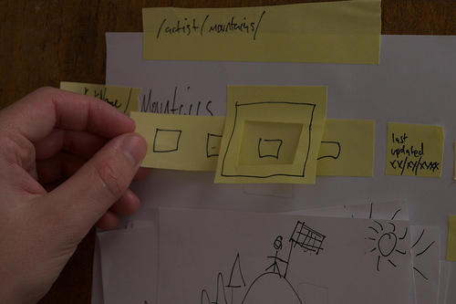
Using Sticky Notes
Combine sticky notes
Demonstrate interactions
Supports templating and brainstorming

Slide 29
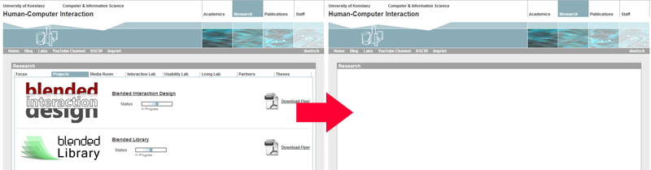
Using Templates
Place sketch into photograph or real website
More efficient and realistic
Example: Crop website area:
My sketch goes here

Slide 30
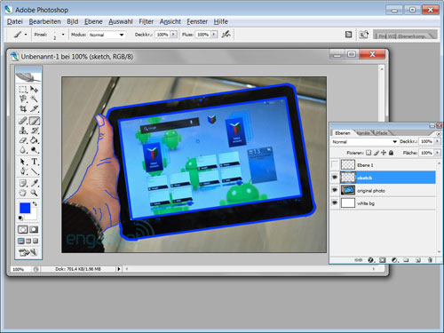
Templates: Photo Tracing
Photograph as template
Re-draw most importat elements on separate layer

Slide 31
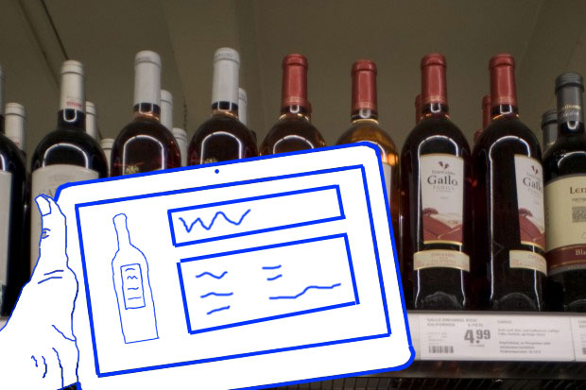
Templates: Hybrid Sketching
Combine sketch with photo
Better indication of project scope

Slide 32
Summary
The Real World
Hunting & Gathering
Getting into mood
Mood boards, Design Funnel
Sketching
Draw what you see,
Templates, PowerPoint

