Slide 1
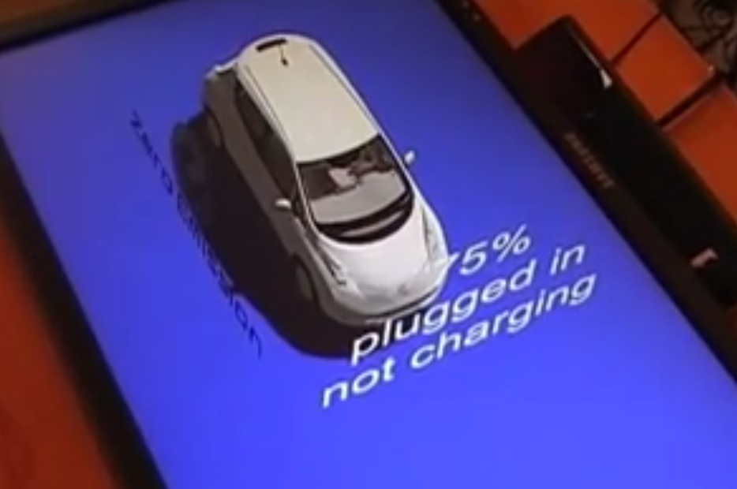
Control car using voice command
Keywords
Control car
Voice command
Input
Computer monitor
Microsoft Kinect
Output:
Text
Speech
Technology:
Unity 3D
Google 3 Dwarehouse
Blender

Slide 2


Control car using voice command
Description:
Car with an specialized API, we can communicate with it over the internet. We also can communicate with Smartphone. We can command the car for specific key word like battery status, range estimation, climate control system activation, etc.
Kinect speech recognition detects the voice command then computer talk to the service of the car which talk to the car to send the necessary commands.
Links:
https://www.youtube.com/watch?v=z0C2Lq2zlcc&list=UUdbcE0K7OvItLdEVVxKpBPA&index=5
https://github.com/haykinson/pycarwings

