Slide 1
RFID
Group 4b:
Javier Castillo-Badillo
Thomas Griesshaber

Slide 2
TABLE OF CONTENT
Type of RFID tags
How RFID works
Application areas
RFID Demo Patches

Slide 3
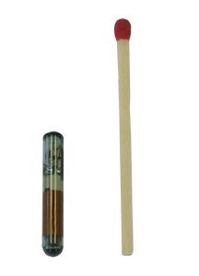
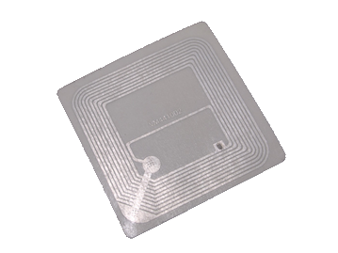
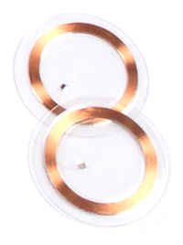
TYPE OF RFID TAGS

Slide 4
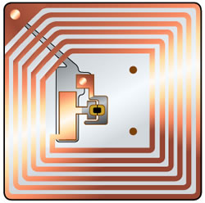
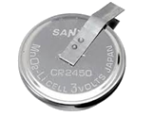
TYPE OF RFID TAGS
PASSIVE RFID TAGS
ACTIVE RFID TAGS

Slide 5
PASSIVE RFID TAG
No integrated power source
Resistant to environmental influences
Possible distances 1 cm – 10 m
Cheap solution (1ct – 5ct per tag)
Antenna
Microchip

Slide 6
ACTIVE RFID TAG
Own power supply
Faster communication
Possible distances 1 cm – 100 m
More expensive (10 - 100€ per tag)
Generally bigger than a passive tag
Antenna
Microchip
Powersource

Slide 7

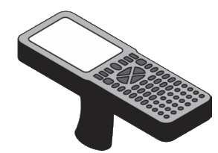

HOW RFID WORKS
Communication process:
RFID Reader
Transmitter sends power as AC
2) Antenna draws energy from the readers signal and converts the power from AC to DC to energize the microchip
Passive Tag

Slide 8
HOW RFID WORKS
Communication process:
RFID Reader
3) Microchip has enough power to operate and sends data to the reader
Passive Tag

Slide 9
HOW RFID WORKS
Communication process:
RFID Reader
4) Receiver fetches the signals from the tag and send it to the processor, which can interpret the analog signals
Passive Tag

Slide 10

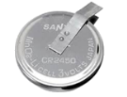
HOW RFID WORKS
Communication process:
RFID Reader
The Active Tag always sends radio signals.
If a reader enters the area of the tag the communication starts.
Active Tag

Slide 11
FREQUENCIES
 | Low frequency | High frequency | Ultra high frequency | Mircowave
RFID frequency | 125 kHz or 135.2 kHz | 13.56 MHz | Passive: 915 MHz US 868 MHz Europe Active: 315 MHz or 433 MHz | 2.45 GHz or 5.8 GHz
Range | Low - max 10 cm | Moderate – 10 cm – 1 m | Moderate – max 12 m | High – 100 m
Data Speed | Low | Low / moderate | fast | very fast

Slide 12
RFID
APPLICATION AREAS
Notes:
Current and proposed uses of RFID span a wide spectrum of application areas

Slide 13
RFID
Anti-theft
Asset management
Inventorying control
Tracking & Tracing
Electronic Payment
Access control

Slide 14
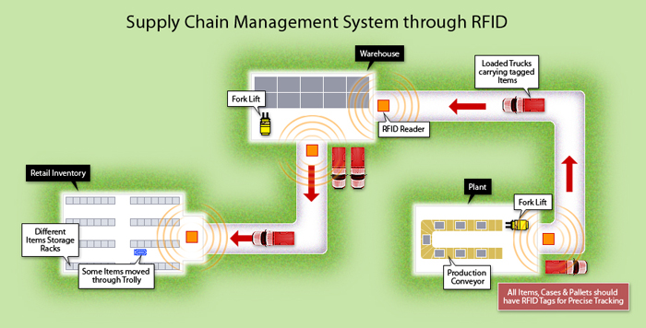
ITEM TRACKING AND TRACING
Attaching a tag on an item to be tracked
Reading this tag at specific locations
http://www.satcomlimited.com/images/supply_chain.jpg
Notes:
The item tracking and tracing application class type is characterized by the following:
•Attaching a tag containing a unique identifier on an item to be tracked
•Reading this tag identifier at specific locations while the item moves
1. At the manufacturer's shipping dock, the container is loaded onto a truck that will leave the manufacturing plant.
2. The container arrives at the receiving dock of the distribution center.
3. At the distribution center's shipping dock, the container is loaded onto a truck that will leave the distribution center.
4. The container arrives at the retailer.
5. The customer buys this container at the sales counter of the retailer.
6. The empty container arrives at a recycling center.

Slide 15
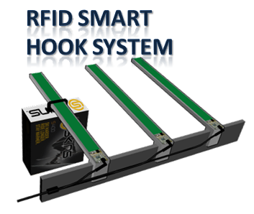
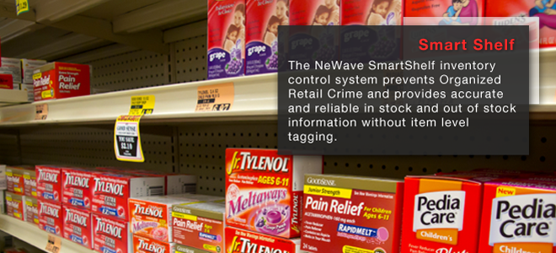
INVENTORY MONITORING AND CONTROL
Attaching a tag on an item to be monitored
Detecting the presence/absence on a periodic basis
http://productlisting.mscmalaysia
http://www.newavesensors.com
Notes:
The inventory monitoring and control application class type is characterized by the following:
•Attaching a tag containing a unique identifier on an inventory item to be monitored
•Detecting the presence or absence of this item in the inventory by attempting to read the tag data on a periodic basis
Smart Shelves
Today, stocking shelves is generally a manual process, one that is often less than optimal. In a smart-shelf application, a tagged item is placed on a store shelf. A single reader or multiple stationary readers mounted on or near the shelf monitor the presence of the tag (and hence the item). When a consumer removes this item from the shelf, the reader(s) can no longer read the tag. Therefore, the tag lists reported by the reader(s) to the inventory system no longer contain this tag. The inventory system then assumes that the item has been removed from the shelf. The inventory system can automatically perform several actions, such as notifying the store ersonnel to replace more items of the same type to avoid an out-of-stock situation. Refer to Figure 4-3 to see a simple example implementation.

Slide 16
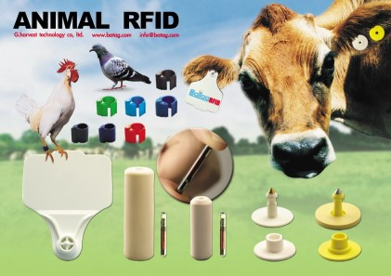
ASSET MONITORING AND MANAGEMENT
Attaching a tag on an asset item to be monitored
Detecting the location and other properties in real time
http://www.rfidhy.com/wp-content/uploads/2013/04/animal-rfid-tag.jpg
Notes:
The asset monitoring and management application class type is characterized by the following:
•Attaching a tag that contains a unique identifier on an asset item to be monitored
•Detecting the location and other properties and states of this item in real time by attempting to read the tag data on a periodic as well as on an on-demand basis
Today, use of RFID is becoming common to track livestock. A tag attached to an animal can be used to monitor its health, movement, and so on. Animal tracking can also be used to track wildlife and fish to monitor their characteristics (such as migration and breeding patterns). ISO 11784 /11785, the international standard for radio frequency identification of animals based on 134.2 KHz technology, is the prominent standard for animal tracking.

Slide 17
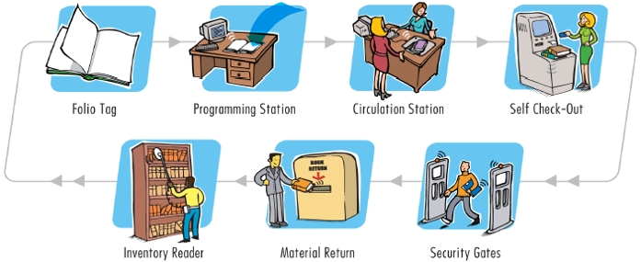
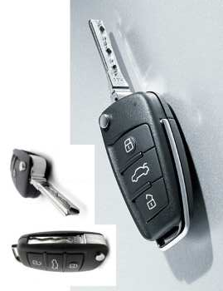
ANTI-THEFT
Attaching a tag to an item to be monitored for theft
Reading the tag ID at the vulnerable points
Alternative or additional features
http://www.micromundi.co.uk/images/stories/library-diagram.jpg
http://www.dvorak.org/blog/images/carkeys.jpg
Notes:
RFID can provide an effective deterrent against theft. A solution of this type is characterized by the following:
•Attaching a tag to an item to be monitored for theft
•Reading the tag ID at the vulnerable points (for example, at exit points, during starting of the ignition of an automobile, and so on)
•Alternative or additional features such as the ability to remove an attached tag from the item only after the correct payment has been made, the ability to detect movement of the attached item and reporting it to a nearby reader, and so on.
An appropriate reader can receive and relay this information to a back-end system. The back end can then initiate various actions. For example, it can either lock the exit(s) through which the item can be taken out of the building, it can trigger an alarm, or it can initiate a video recording of the place where the item is currently located

Slide 18
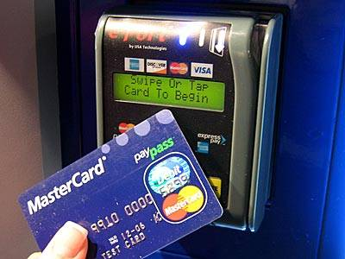
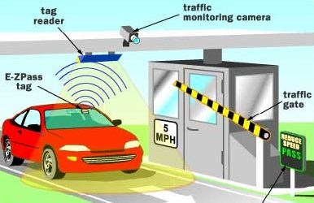
ELECTRONIC PAYMENT
A tag that contains a unique customer number
Reading this customer tag data at the POS
http://m2worldwide.files.wordpress.com/2011/11/rfid_card_reader.jpg
http://trak.in/wp-content/uploads/2010/07/automatedtollbooth.jpg
Notes:
This electronic payment application class type is characterized by the following:
•A tag that contains a unique customer number
•Reading this customer tag data at the POS
Electronic Toll Payment
Toll agencies in the United States and other countries use RFID to allow drivers to pay for tolls electronically at toll booths. A customer opens an account with a predefined amount of money with an agency that is responsible for toll collection. The customer then receives a tag with a unique ID. This tag is mounted, generally on the vehicle's windshield (see Figure 4-5), so that it can be read properly by readers at toll booths. When this customer drives through a toll booth that accepts
electronic payment, the tag ID is read, the associated prepaid account is accessed, and the toll amount is subtracted from the account balance—automatically. The tag can display the account status by turning on its different-colored indicators.

Slide 19
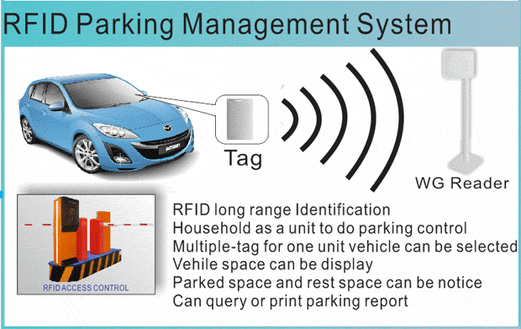
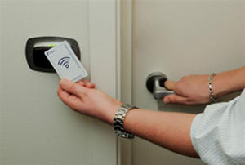
ACCESS CONTROL
A tag that is carried to gain access
Reading the tag ID data at the access control points
http://img.archiexpo.com/images_ae/photo-g
http://www.parking-equipments.com/uploads/2.4G-reader.gif
Notes:
•A tag that contains unique identification data and that is carried by the object or the person to gain access (for example, a tag placed on a vehicle windshield, embedded in an person's ID badge or under his skin)
•Reading the tag ID data at the access control points (with the ID then being forwarded to a security system that decides the actual access permission)
Perimeter and Building Security System
This RFID application member is used for securing access to specific areas of a location (for ex- ample, a loading dock of a warehouse or a building). An example of the latter is the entry gate of a highly secured building (for example, an army headquarters), access to which, if compromised, could lead to danger of the personnel working in the building (besides the negative publicity that might result from such an incident).

Slide 20
RFID WITH ARDUINO
https://vimeo.com/18942527 door entering
https://www.youtube.com/watch?v=45E-Otpule4 kid log
https://vimeo.com/10896151 cat feeder 1
https://www.youtube.com/watch?v=8uTz10jGBFk cat feeder 2
https://www.youtube.com/watch?v=faDX9L4YE8c car start
https://www.youtube.com/watch?v=tY-qSTJYMyI door opener

Slide 21

OUR DEMO PATCH

Slide 22
THANK YOU FOR YOUR ATTENTION

Slide 23
REFERENCES
[1] http://proquest.tech.safaribooksonline.de/book/hardware/rfid/0131851373
[2] http://electronics.howstuffworks.com/difference-between-rfid-and-nfc1.htm
[3] Arjun Agarwal and Mala Mitra. RFID: Promises and Problems, April 2006.

