Slide 1
Visual Storytelling
Seminar: Sketching User Experience
“A good story is worth a thousand pictures.”
Gershon & Page, 2001

Slide 2
Motivation
Once upon a time . . . there was a lovely little princess named Snow White who was forced to dress in rags and do menial work around the castle by her wicked stepmother, the Queen.
[3]
Notes:
Once upon a time…
Stories = Mindplay sketches
Triggering of pictures of human experience (imagination, childhood memories, common sense)
Why are stories so important?
Memorable
Can and may will be retold

Slide 3
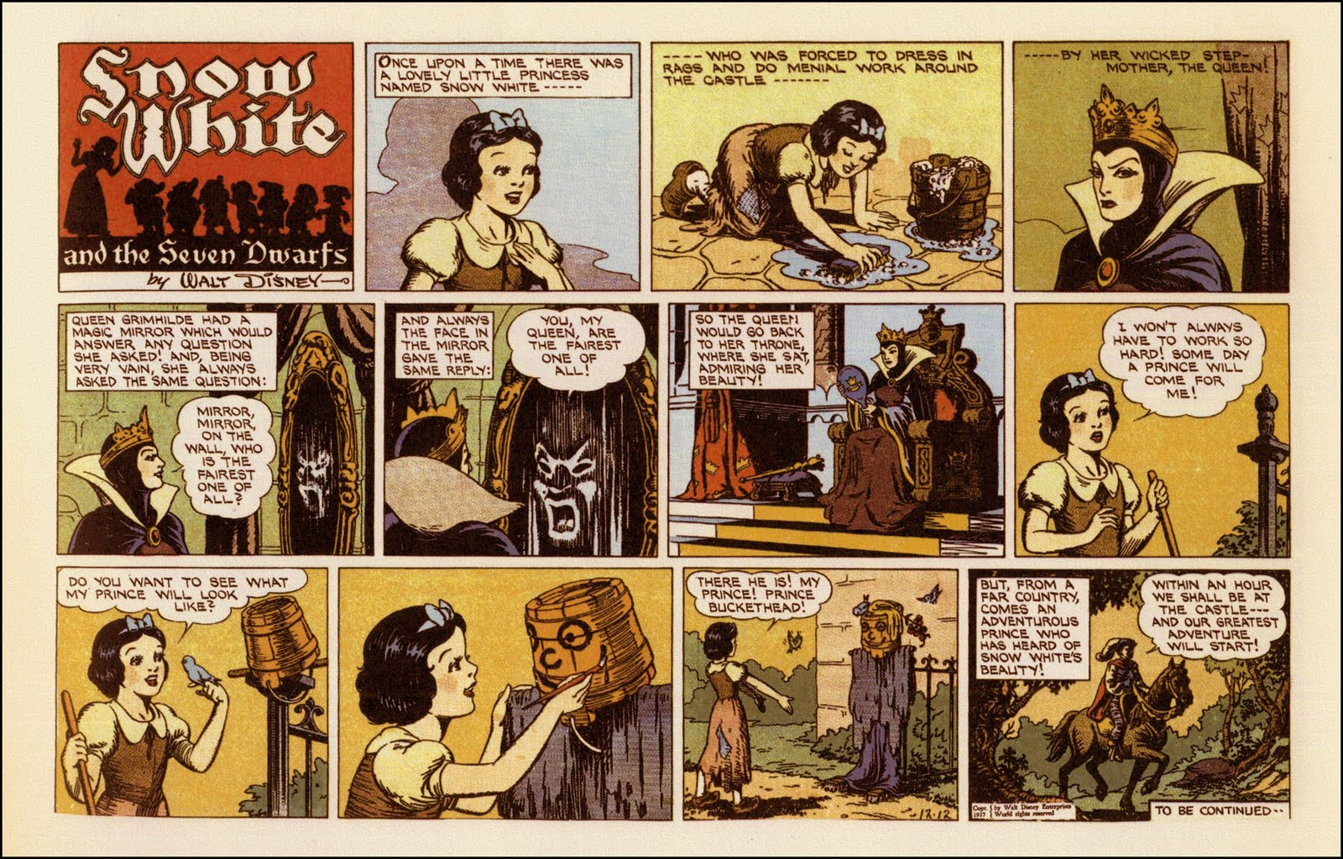
Motivation
[3]
Notes:
- Story told in pictures
Most famous are comics
Annotated
Imagination between the pictures

Slide 4
Contents
Storytelling
  The Storyline
  The Scenario
  Role Playing
Storyboards
  Types of Storyboards
  The State Transition Diagram
  How to Sketch a Storyboard
Sketch Boards
Summarization

Slide 5
Storytelling
The Storyline
The Scenario
Role Playing

Slide 6
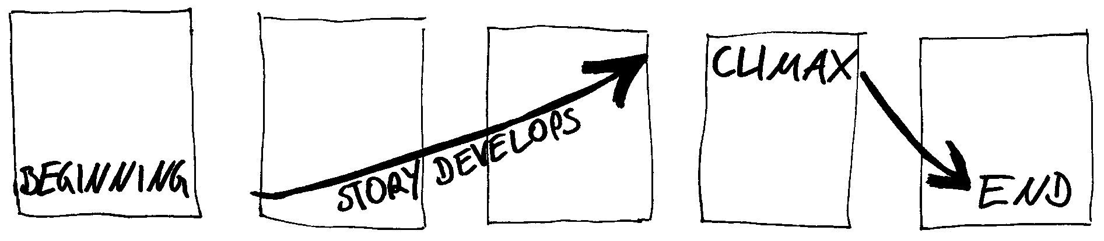
Storytelling
Where does the interaction takes place?
What is the problem?
What is the task that people are trying to do?
Which people are present and what are their actions?
What kind of objects or digital devices do they use?
What is the possible input and output for each digital system?
How do the actions of people and/or devices solve the problem?
The Storyline
[2]

Slide 7
Storytelling
  A group is discussing in a bar and does not know if some fact is right or wrong.
  Luckily everybody has a smartphone in the pocket.
  Therefore they start googling the question, each of them with their own smartphone.
  Then they are comparing the results…
  … and discussing the which answer could be right.
The Scenario

Slide 8
Role Playing
  Play the role of the user
    E.g. Tape fingers to experience arthritis
  Humans play the role of devices
    What does it feel to be a smartphone?
  Deeper and better understanding of the user and the purpose of the device
  Become “at home” to develop a home-system
  “Interaction is about roles and their changing relationships” (Bill Buxton)
  Can lead to theatrical sketches
[1]

Slide 9
Storyboards
Types of Storyboards
The State Transition Diagram
How to Sketch a Storyboard

Slide 10
Storyboards
  Representation of connected states, each branch following a storyline
  These states are containing sketches of the user interface, a abstraction or the sketch of a situation
  Each state captures a single moment in time
  A complete sequence shows how the user experience unfold over time
  All sketches are simultaneously visible distributed in space at the same time (space multiplexed)
  Chosen sketching method needs to incorporate actions, interactions and changes of the user experience across time
[1,2]

Slide 11
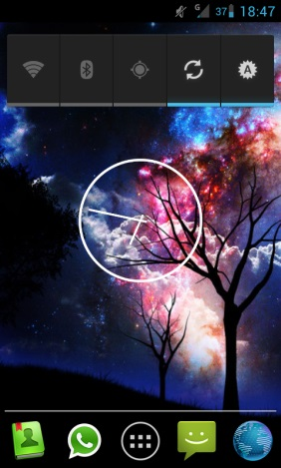
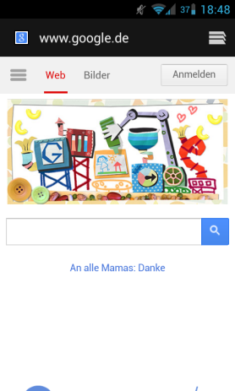
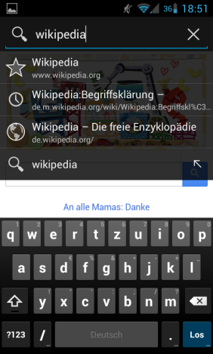

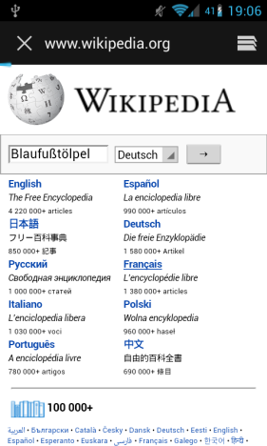
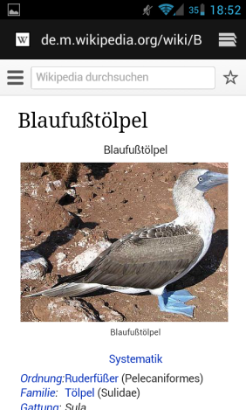
The Sequential Storyboard
Select the application “browser”
Select the address field
Home screen
Start page of the browser
Preview of the address field
Type in “wikipedia.org” and press Go
Type in “Blaufußtölpel” and press Go
Wikipedia.org
Main page
Page of the searched term
[2]
Notes:
Sketch is a key frame or state
Space between these frames captures the transition
Space has to be filled by imagination of viewer
Key challenge is to decide what sketches to include as key frames and the transitions
Annotate the storyboard to explain the users interaction that happened during the transitions

Slide 12

The State Transition Diagram
Abstract State Transition Diagram
Browser
Start screen
Browser
Address
field
Home
Select the app-lication “browser”
Select the address field
…
Visual Interface State Transition Diagram
Select the app-lication “browser”
Select the address field
…
[2]
Notes:
Also existing annotated state transition diagram

Slide 13
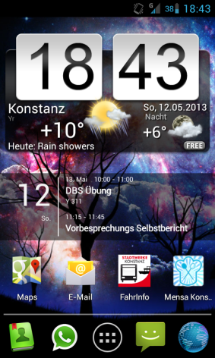
The State Transition Diagram
Indexed State transition Diagram
Browser
See 2
Browser
See 3
Home
See 1
Select the app-lication “browser”
Select the address field
1
2
3
Possible home screens
Start page
Address field
[2]

Slide 14
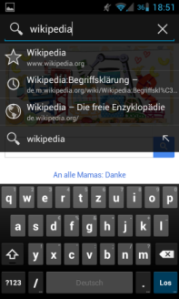

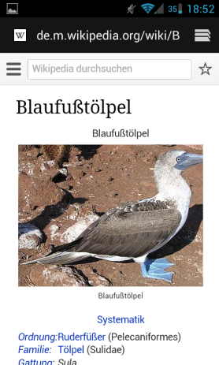
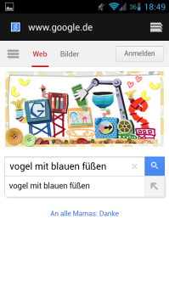
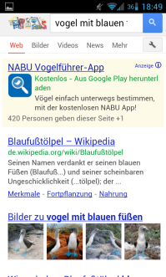
The Branching Storyboard
Mixture of abstract, visual interface and indexed state transition diagram
1
2
3
4
5
Go
Search
Field & Go
Address field
5
Search
field
Choose
result
Go
[2]

Slide 15
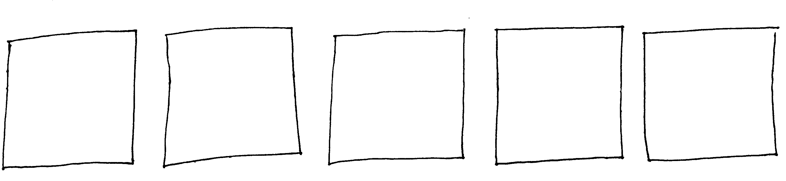
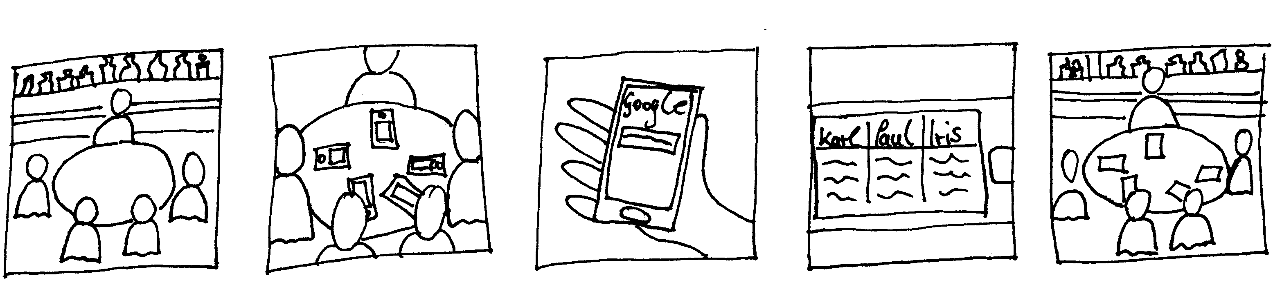
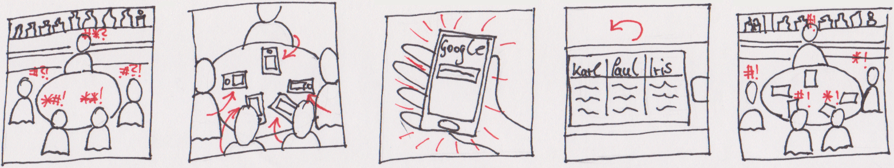
The Narrative Storyboard
Outline storyboard frames
Develop the storyline
Draw storyline sketches with appropriate camera shots
Emphasize actions and motions
Demonstrate to other and iterate
  A group is discussing in a bar and does not know if a fact is right or not.
  Luckily everybody has a smartphone in the pocket.
  Therefore they start googling the question, each of them with their own smartphone.
  Then they are comparing the results…
  … and discussing the answers.
[2]
Notes:
5 boxes are limiting the interaction shown in the storyboard to one particular scene -> benefit
More frames are of course always possible
Also possible to do narrative storyboards with photos

Slide 16
Sketch Boards

Slide 17
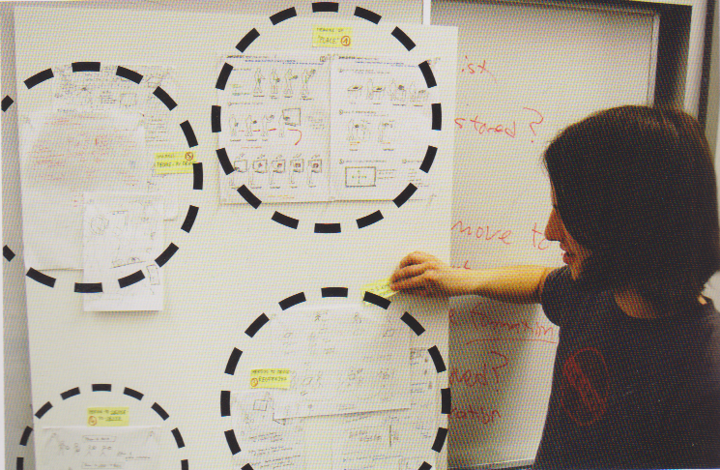
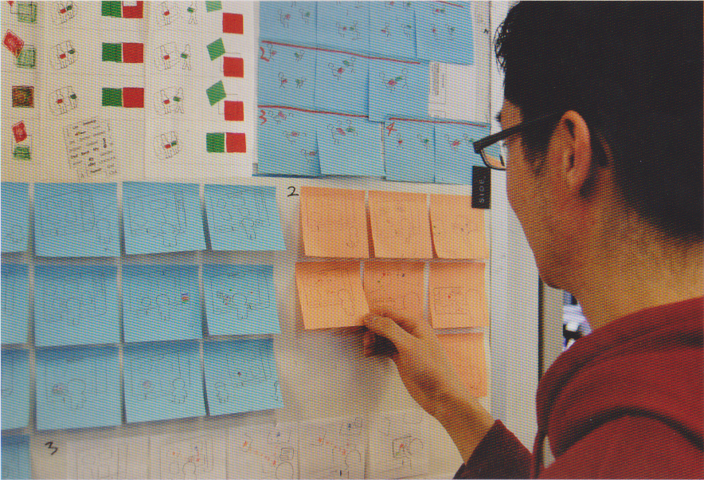
Sketch Boards
  Foam core poster sheets
  Sticky notes and
  whiteboards
  Arrange the sketches around your desk
  Discuss the sketches during meetings
  Place the sketches in public areas
    At the work group or the customer location
[2]
Notes:
Foam core:
Complete sketches are used (photo-copies, if sketches are from sketchbook)
See categorized and classified sketches on a foam core
Easily transportable, but not good to rearrange able
Sticky notes and whiteboards:
Each picture und a stoybote
Categorized and classified by sticky note color and other annotations
Easy to rearrange, but badly transportable
If presenting sketches in public areas prepare a comment box or leave your contacts.

Slide 18
Summarization

Slide 19
Summarization
  Storytelling
    Paperless technique to explore use cases and ideas
    Structure of a story: beginning, climax, end
    Possibility of playing the role of the user or the device
  Storyboards
    Space multiplexed presentation of interaction sequences (based on state transition diagrams)
    Used to analyze one ore more interaction sequences (sequential or branching storyboards)
    Based on storylines and suitable sketches to analyze the context of the interaction (narrative storyboards)
  Sketch Boards
    Used to share sketches and ideas for discussions and reconsidering/rethinking
    Can be static or transportable and placed around your desk or in public areas
[1, 2]

Slide 20

Example
Narrative Storyboard
[4]
Notes:
Good home bringer???
Video einbettung muss noch gemacht werden, weil der Media-Player im moment deaktiviert ist. :D

Slide 21
The End
Questions?

Slide 22
Sources
  [1] Sketching User Experience, Bill Buxton 2007
  [2] Sketching User Experience – The Workbook, Greenberg et. al 2011
  [3] Filmic Light Snow White Archive
  [4] Interaction Design –Storyboard, mrflasheye

