Slide 1
Microcontroller
Seminar:- Physical Computing
Presented by
Imran Mehmood
Kritika Rajbandhari
Group:- 2C

Slide 2
Overview
What is a Microcontroller?
History of Microcontroller.
Structure and Interfacing of Micro controller
How to program a Micro controller
Applications of Microcontroller.
Arduino Microcontroller(why, structure,interfacing,)
Phidgets Microcontroller
Arduino vs Phidgets

Slide 3
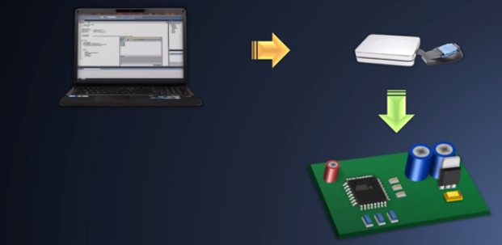

What is a Microcontroller?
An integrated circuit ..
“ A microcontroller needs to be programmed to be useful as the code is written for it. “
Designed for embedded applications
Notes:
1-> That is programmed to do a specific task,
2-> If you want to turn on red light when a temperature reached on some certain point , the programmer would have to explicitly specify how that will happen through its code.
figure -> second one is a hardware(in-circuit serial programmer) not a person… which converts program into binary code.

Slide 4
Evolution of Microcontroller
Vaccum tubes, Transister, IC and Micro controller
First Microcontroller 8051 developed by intel in 1980
8 bit intruction set and programmed with C language

Slide 5
Micro Controller Architecture
Microcontroller
Sensor
Actuator

Slide 6
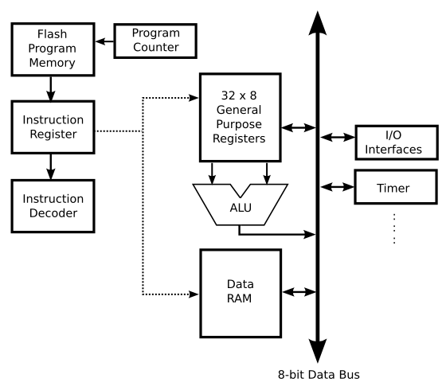
Micro Controller Basic Architecture

Slide 7
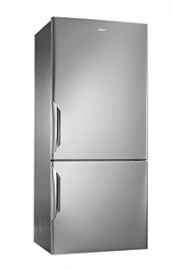

Applications of Microcontroller
Micro controllers are everywhere in daily life
Security system
Transport system
Home Appliances
Automatic control system
Light Sensing and Control devices
Fire detection and safety
Temperature Sensing and Control
Measuring Instrument(voltage)
Telecommunication

Slide 8
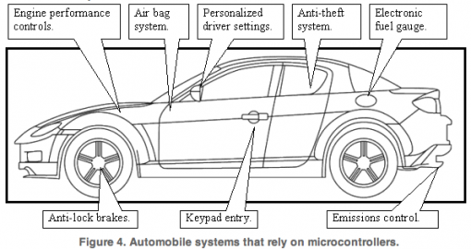
Application Example

Slide 9
Types of Micro Controller
Low level Micro controller like PIC microchip
Mid Leve like Arduino
High Level like Phidget

Slide 10
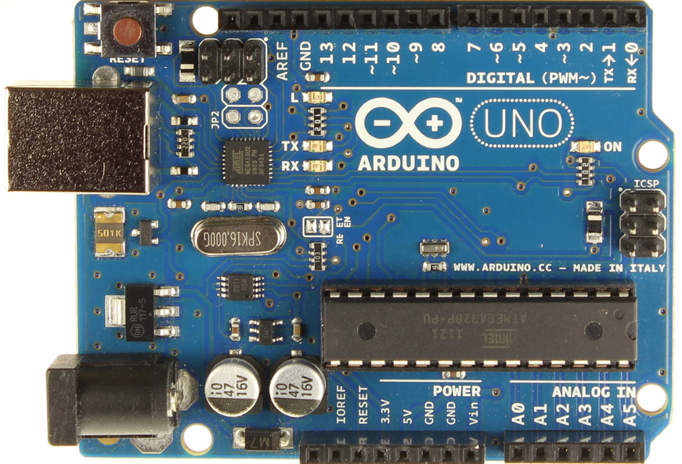
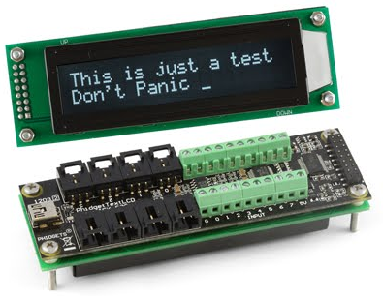
Types of Microcontroller
Arduino
Phidgets

Slide 11
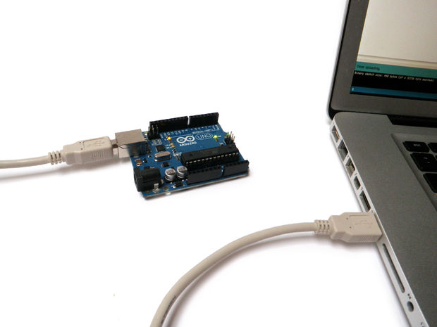
Arduino
Arduino was introduced in 2005 in Ivrea, Italy
An Arduino is an open-source microcontroller development board.
Notes:
An Arduino is an open-source microcontroller development board. In plain English, you can use the Arduino to read sensors and control things like motors and lights. This allows you to upload programs to this board which can then interact with things in the real world. With this, you can make devices which respond and react to the world at large.

Slide 12
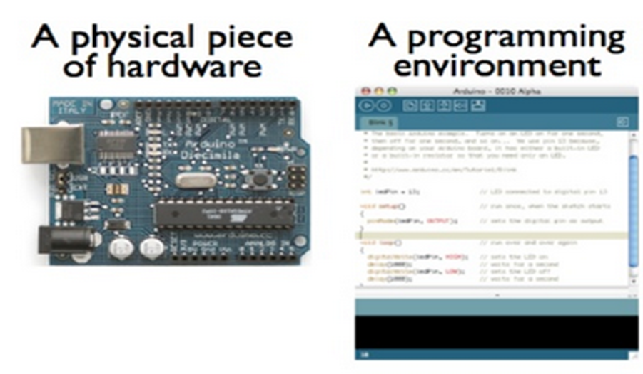
Notes:
Before you can start doing anything with the Arduino, you need to download and install the Arduino IDE (integrated development environment). From this point on we will be referring to the Arduino IDE as the Arduino Programmer.
The Arduino Programmer is based on the Processing IDE and uses a variation of the C and C++ programming languages.

Slide 13
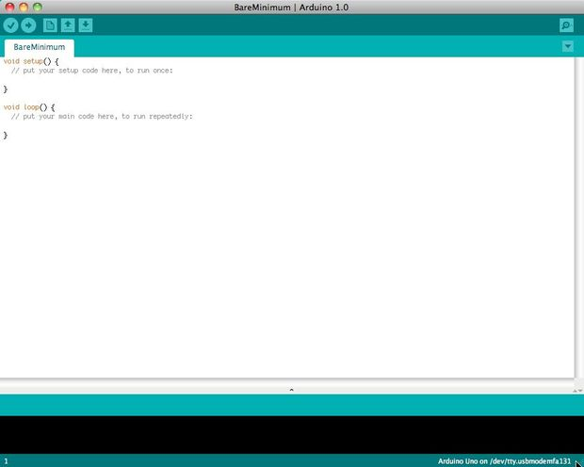
Programming an Arduino
Write program,
Compile and check ,
Reset boards,
Upload to board.
Notes:
The Arduino Programmer is based on the processing IDE(Integrated development environment) and uses a variation of C and C++ programming languages.

Slide 14
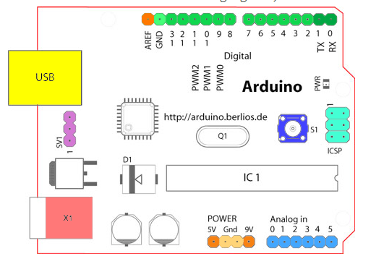
Arduino Hardware

Slide 15
Analog Reference pin (orange)
Digital Ground (light green )
Digital pins 2-13 (green)
Digital Pins 0-1/Serial In/Out – TX/RX (dark green)
Reset Button –S1(dark blue)
In-circuit Serial Programmer(blue green)
Analog in Pins 0- (light blue)
Power on ground pins(power:orange,lgrounds:light orange)
External Power Supply -X1(pink)
Toggels external power and USB power (purple)
USB(Yellow )

Slide 16
Arduino shields
Shilds are expansion adapter boards that plug in over top of the Arduino boards.
There are many types of Arduino Shileds:
  Wireless SD Shield.
  Ethernet,
  Motor
  Xbee,
  Breadboard,
  Voice,
Notes:
Since the Arduino is open hardware, anyone who has the inclination is free to make an Arduino shield for whatever task they wish to accomplish

Slide 17
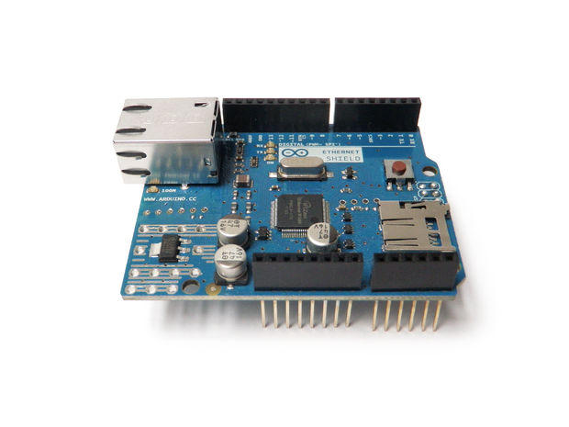
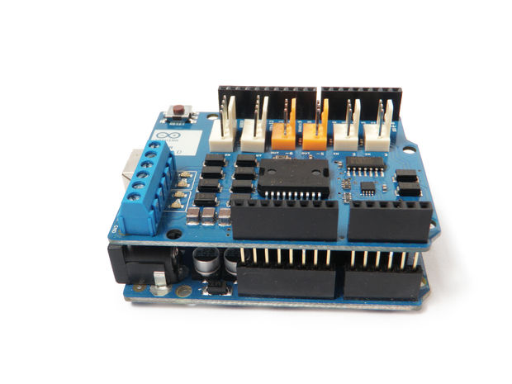
Contd……
Arduino Ethernet Shield
Arduino Motor Shield
Notes:
1) The wireless SD shield supports Xbee modules. These modules allow for easy wireless serial communication. A standard module has the range of 100 - 300 feet.
2) The Arduino Ethernet Shield allows you to easily connect your Arduino to the internet. This shield enables your Arduino to send and receive data from anywhere in the world with an internet connection. You can use it to do fun stuff like control robots remotely from a website, or ring a bell every time you get a new twitter message.
3) The Arduino Motor Shield allows you to easily control motor direction and speed using an Arduino

Slide 18
Why Arduino
Inexpensive,
Cross Platform
Simple, clear programming environment,
Open source and extensible software,
Open source and extensible hardware. (ATMEGA8 & ATMEGA168)
Notes:
1 -> Arduino modules cost less than $50,
2 -> The Arduino software runs on Windows, Macintosh OSX, and Linux operating systems. Most microcontroller systems are limited to Windows,
3 -> The Arduino programming environment is easy-to-use for beginners, yet flexible enough for advanced users to take advantage of as well,
4-> The Arduino software is published as open source tools, available for extension by experienced programmers. The language can be expanded through C++ libraries, and people wanting to understand the technical details can make the leap from Arduino to the AVR C programming language on which it's based. Similarly, you can add AVR-C code directly into your Arduino programs if you want to.
5 ->

Slide 19
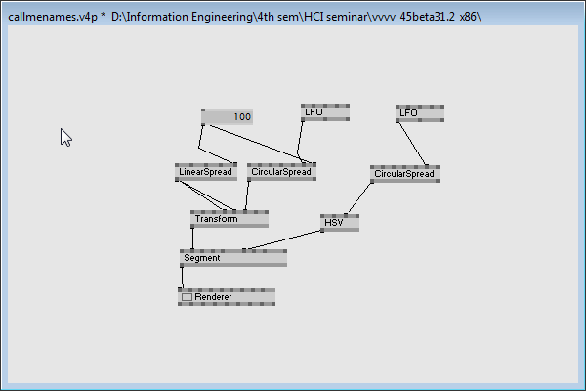
Patch Of VVVV

Slide 20
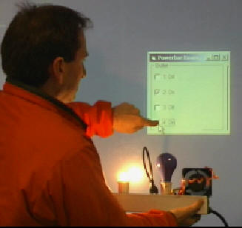
Phidget Micro Controller
A phidget is physical representation or implementation of GUI widget
Phidgets are to Physical interfaces as widgets are to the graphical user interfaces
Phidgets are changing the world form GUI to tangible user inface(TUI)

Slide 21
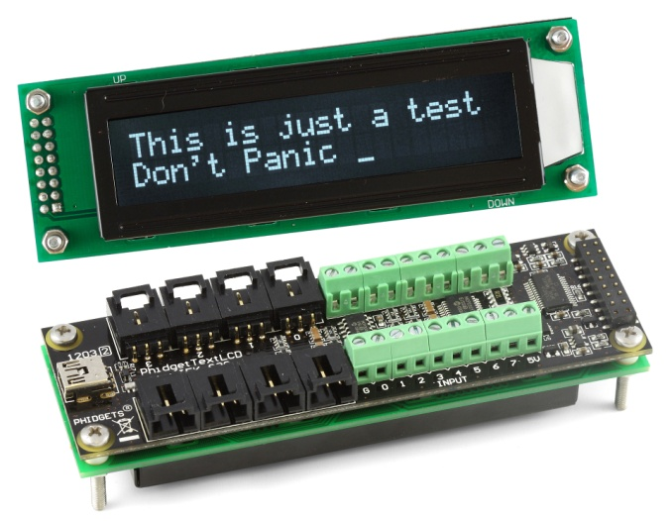
Phidget Micro Controller
Phidgets are easy to use Building blocks
Low cost sensing and conrolling from pc
Use Universal serial bus as interface
Programable using languages like C or java
Complexity is managed by API
Use Sensors and motors for interaction

Slide 22
Phidget Interface Hardware
Computer/USB Port
Phidget Interface Board available in variable Input and Output Size
Phidget Sensors with Interface cables
Motors
Phidget Actuators controllers
Relays
RFIDs

Slide 23
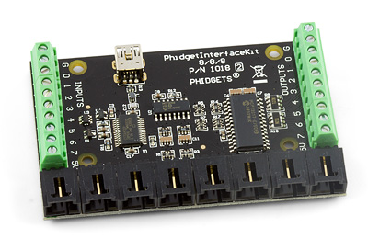
Phidget Interface Board(8/8/8)
8 Analog Inputs
8 Digital Inputs
8 Digital Outputs
USB Port
Core Processor

Slide 24
Phidget Sensors
Force Sensor
Motion Sensor
Rotation Sensor
Phidget Slider or Potentiometer Sensor
Light Sensor
Mini Stick Sensor
Pressure Sensor……..

Slide 25
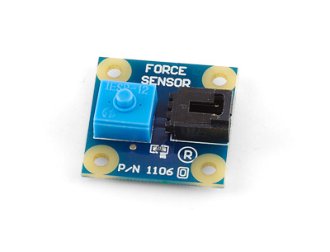
Phidget Force Sensor
Can be used as a button for human input or
To sense the presence of small object
Force Sensor measures up to 3 kilograms
Has 60cm sensor cable

Slide 26
Phidget Motors
Phidget has following motors and controllers
Servo motors
Actuator Controllers
Stepper Motors
Stepper Controllers
DC motors
DC controllers

Slide 27
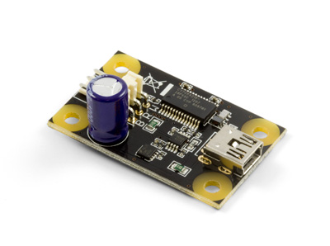
Phidget Servo Motors
Control one RC servo Motor or actuator
Control Velocity,postion and Acceleration
Power solely by computer via USB
Rotational movement
Like in Hard Disk platter

Slide 28
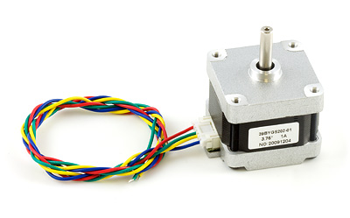
Phidget Stepper Motor
Provide good torque as less resolution
Head movment in Hard Disk is controlled by a Stepper motor
Back and forth movement

Slide 29
Phidget Hardware Model
All phidgets are connected to computer via USB
Most computer support more than 127 devices
Can be directly connected to PC or through Hub
The maximum cable length for USB connection is 15 feet
Supported on USB port 1.1 and 2.0

Slide 30
Phidget Software Model
Operating system support win 2000 or later
Bottom level API is C library phidget 21
It is cross platform library and use low level protocols
Other higher level libraries are com,.NET,Java, Python
Also provided with Phidget webservice

Slide 31
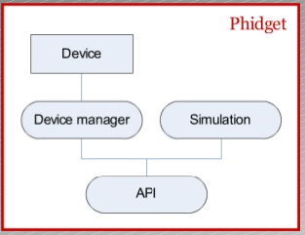
Phidget Software Model

Slide 32
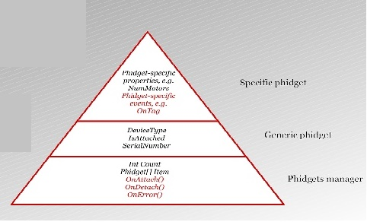
Phidget Software Model….

Slide 33
Phidget Goals
To provide Physical Interaction
Make easy for non specialized experts to create(don’t need a hardware implementation vision and Expert)
Abstract proper functionality through a well defined API
Hide hardware implementation details

Slide 34
Phidget Values
Low Cost
Reusable
Versatile
Rapid Prototyping for Physical Interfaces

Slide 35
References and Citation
Http://www.phidgets.com
Http://www.phidgets.com/documentation/sensors.pdf
Http://www.phidgets.com/documentation/1016.pdf
Http://www.phidgets.com/documentation/1012.pdf
Http://www.phidgets.com/docs/1018.pdf

Slide 36
http://www.slideshare.net/zvikapika/introducing-arduino.
http://en.wikipedia.org/wiki/Arduino.
http://arduino.cc/en/Guide/Introduction

Slide 37
Thanks For Your Attention !!

