Slide 1
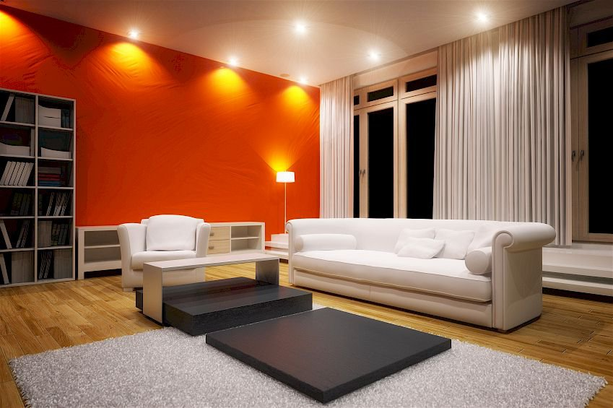
Situational dimming
Situation:
Beeing in the livingroom (or every other room) and doing some activities.
Target Group:
Everyone (with a room and light)
Setting:
Livingroom, kitchen, office doing some things like reading a book, watchin TV, listening to musik, cooking and the light situation will change to your needs
Themes:
Reacting to changing situation (radio on/off)
Light brightness control and color change

Slide 2
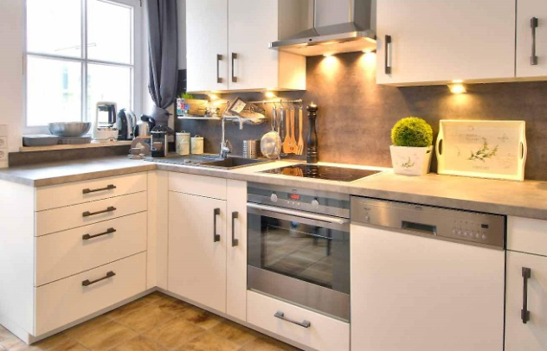
Situational dimming
„You are in the kitchen and about to cook something great. You have all your parts prepared and start to cut you vegetables, recognizing that the light situation is much too dark so you stop, wash your hands and turn the lights on. After you have finished your cooking your taking the pot and walk into the the dining room unable to turn the lights of again having the pot in both hands. So you have to get back to turn the lights off after you put down the pot.“
Notes:

