Slide 1
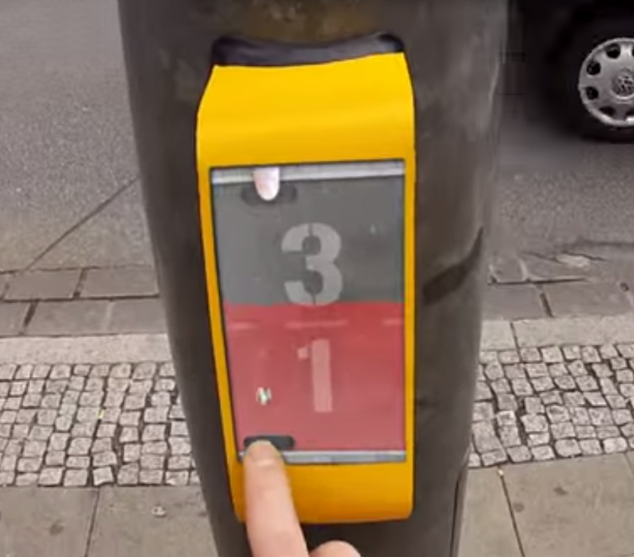
Streetpong
Keywords
Game, Traffic
Input
touch
Output:
Game with score
Technology:
Never implemented – just demo example

Slide 2
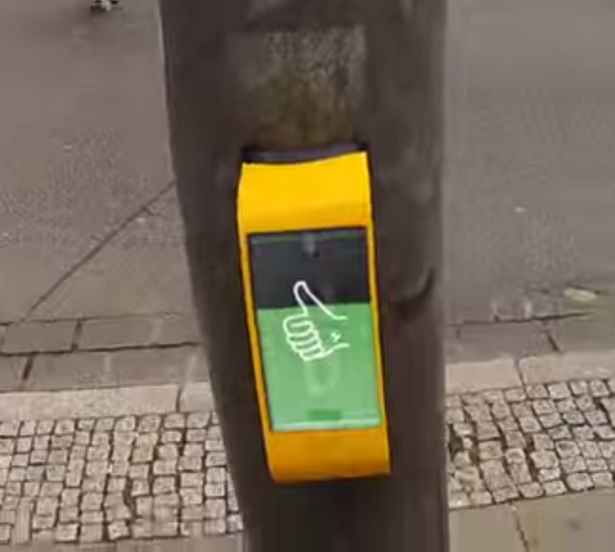
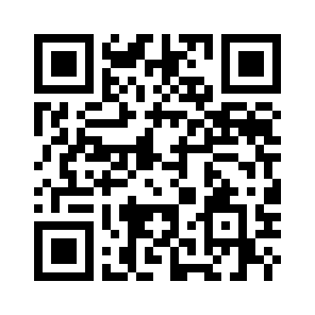
Streetpong
Description:
Streetpong is a pong game to shorten the waiting time at pedestrian lights. The pedestrians will play against each other at the red phase of the lights and play till the lights goes green again. Winner is the player who made the most goals in the waiting time.
The system never got implemented and is just a video demonstration of how a system like this could look like.
Links:
http://www.youtube.com/watch?v=Oe3TsxVSnpg

