Slide 1
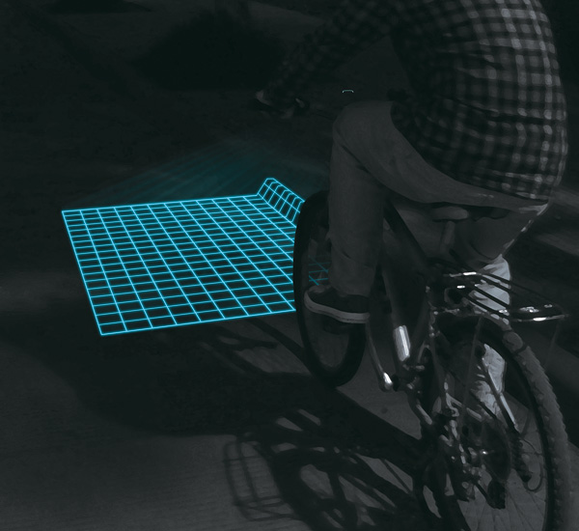
Lumigrids – LED bicycle light
Keywords
LED, Traffic
Input
Output:
LED Projection
Technology:
probably Arduino

Slide 2
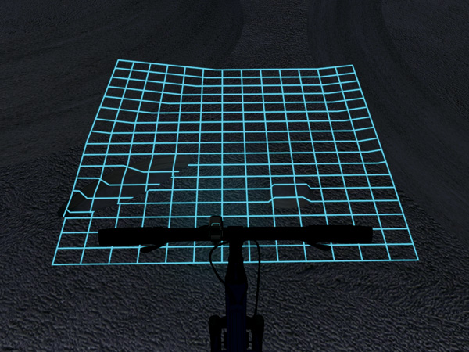
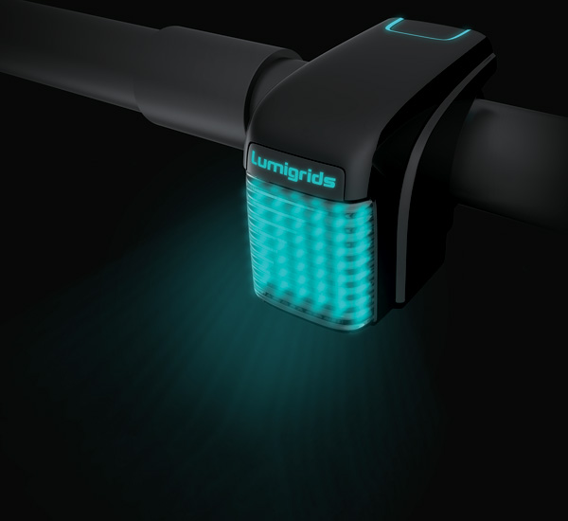

Lumigrids – LED bicycle light
Description:
Lumigrids is an LED projector for bicycles that hopes to improve safety during night riding. It projects square grids onto the ground and by observing changes in the grids, the rider can easily comprehend the landforms ahead. Lumigrids can be fixed onto the bicycle’s handlebars and the power is supplied by either an internal battery or by the rotation of the bicycle’s wheels.
On a flat road surface, the grid will consist of standard squares. On a rough road surface, the grids will deform accordingly. By observing the motion and deformation of the grids, the rider can intuitively understand the landforms ahead. In addition, the luminous grids can make it easier for nearby pedestrians and vehicles to notice the bicycle, reducing the likelihood of collision.
Links:
http://www.yankodesign.com/2013/05/21/lumigrids-while-cycling/

