Slide 1
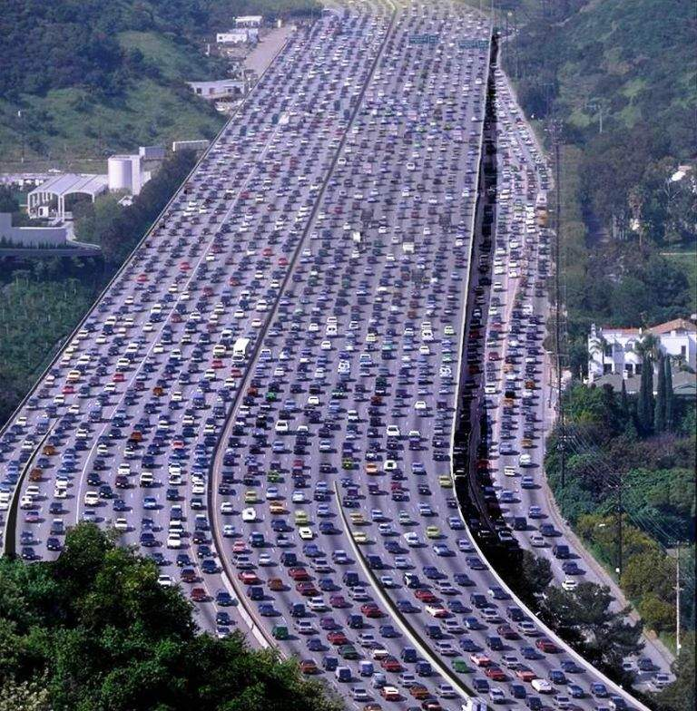
Traffic jam
Situation:
A number of cars blocking each other and no one can move or only slowly
Target Group:
All driver of cars and motorbikes are addressed
Setting:
On a highway, in the city at high traffic times.
Themes:
Count length of traffic jam
Let driver play against each other
Communication with other drivers
statistics about nearby cars (most expensive car, most cars are from Konstanz…)

Slide 2
Traffic jam
Traffic congestion is probably the most boring part of driving. It also happens everyday and costs the economy billions. Sometimes it happens unexpected, sometimes you know you will stuck in it, but we always wish to avoid it
Notes:

