Slide 1
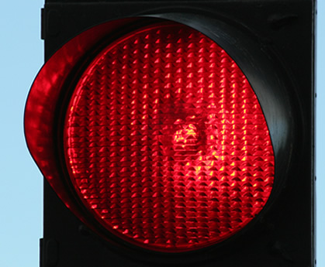
Red pedestrian light
Situation:
A person wants to walk over a street and has to wait for the lights to turn green
Target Group:
Pedestrians
Setting:
City traffic. Pedestrian lights with long red phase
Themes:
Games to motivate pedestrians to wait at the red phase
Show News
Show statistics about the number of pedestrians who already passed the lights.
Show remaining waiting time

Slide 2
Red pedestrian light
You want to cross a huge intersection and have to wait at the lights. Quickly you get bored from the waiting time and start looking for a gap to cross the street. It is difficult to motivate pedestrians to wait at the red lights instead of crossing the intersection. Local points of attraction can minimize the feeling to waste time at the red lights.
Notes:

