Slide 1
Gesture Tracking
Leap Motion and Kinect
By
Michael Simmet and Qaiser Jamal

Slide 2
What is Gesture Tracking?
Gesture recognition helps computers to understand human body language. This helps to build a more potent link between humans and machines, rather than just the basic text user interfaces or graphical user interfaces (GUIs). These old-fashioned input methods still limit all inputs to mouse and keyboard.
The most common tracking technology is video tracking. That is what this presentation is about.

Slide 3
General requirements for a tracking system
Similar to the requirements of photography, consisting out of:
  Illumination
  Definition
  Distortion
  Resolution
  Frame rate
  Reflections
  Background

Slide 4
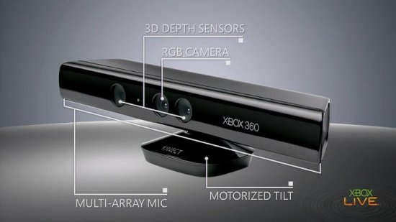
Kinect
Infrared sensors
RGB camera
Microphone
Motor

Slide 5
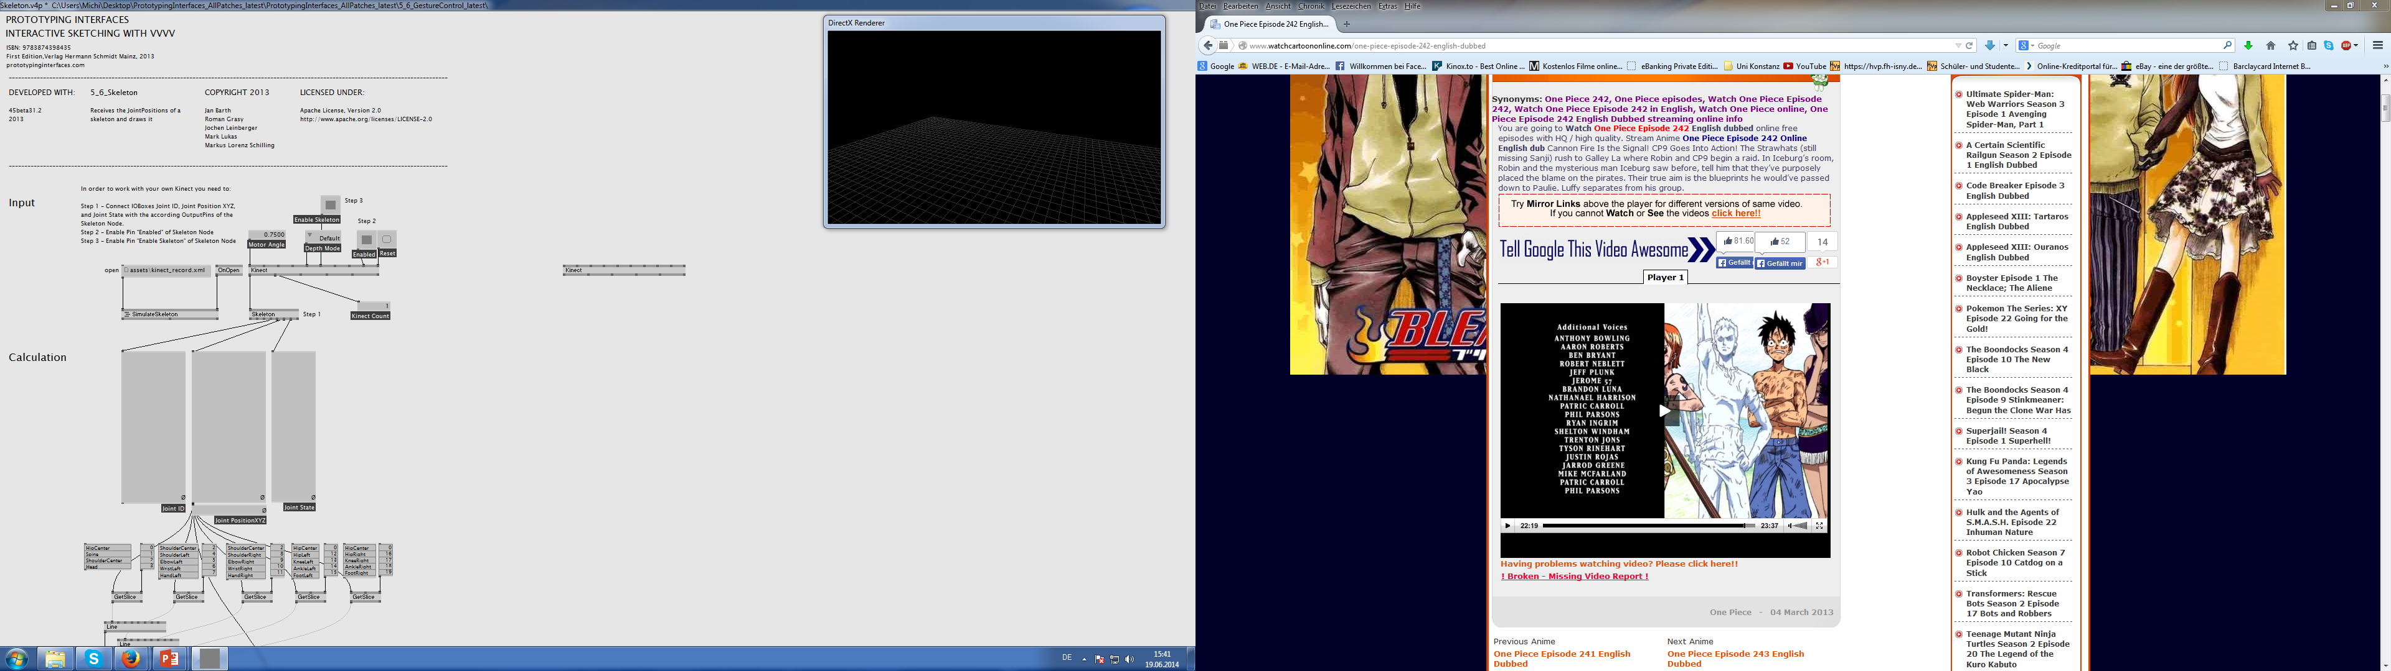
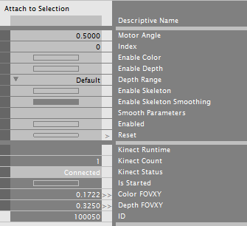
Kinect in VVVV
Kinect Node:

Slide 6
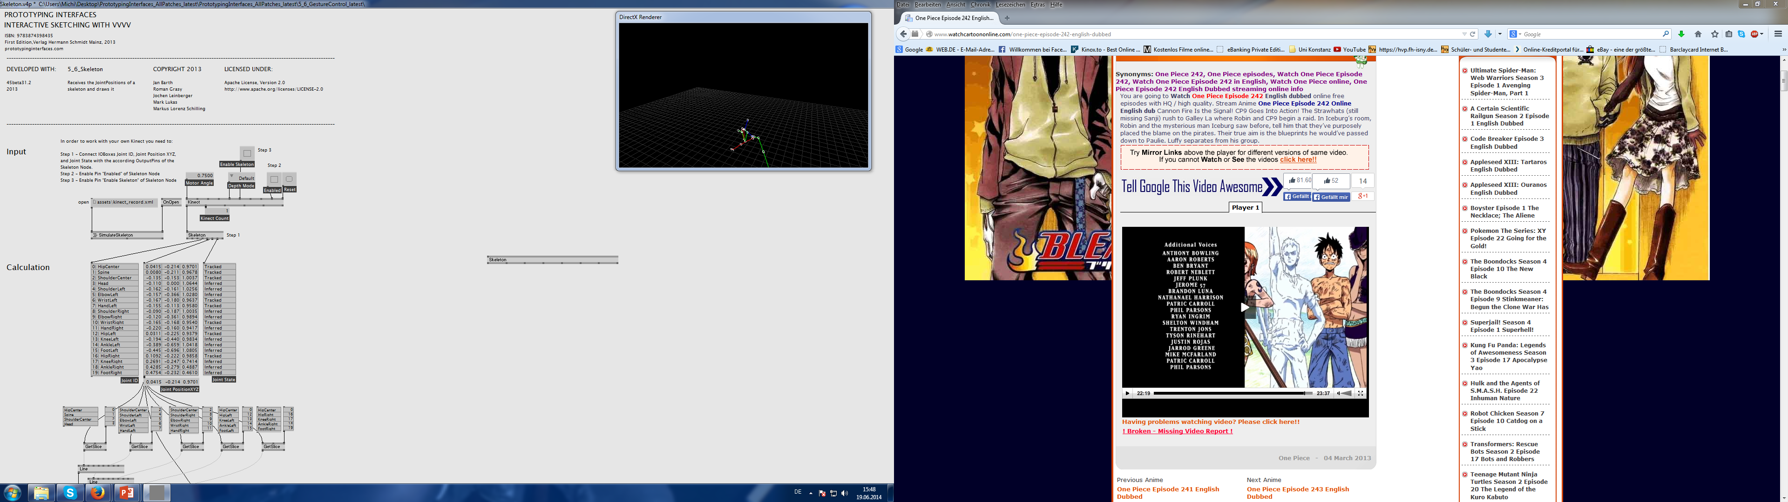
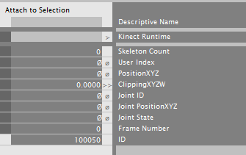
Skeleton Note:

Slide 7
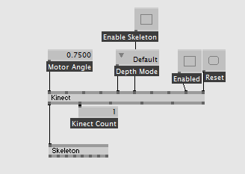
Together:

Slide 8
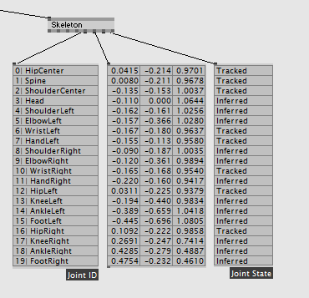
Data of the single parts of the body:

Slide 9
Kinect skeleton demo patch
Demo patch Kinect

Slide 10
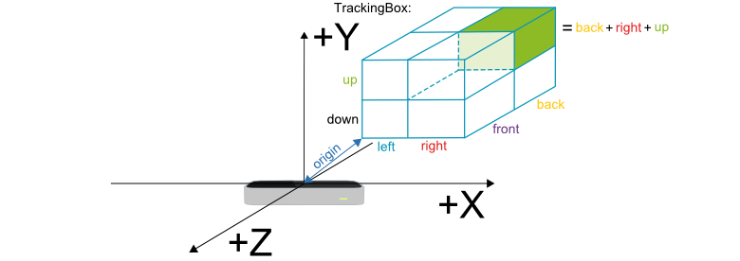
Leap Motion
two monochromatic IR cameras
three infrared LEDs

Slide 11
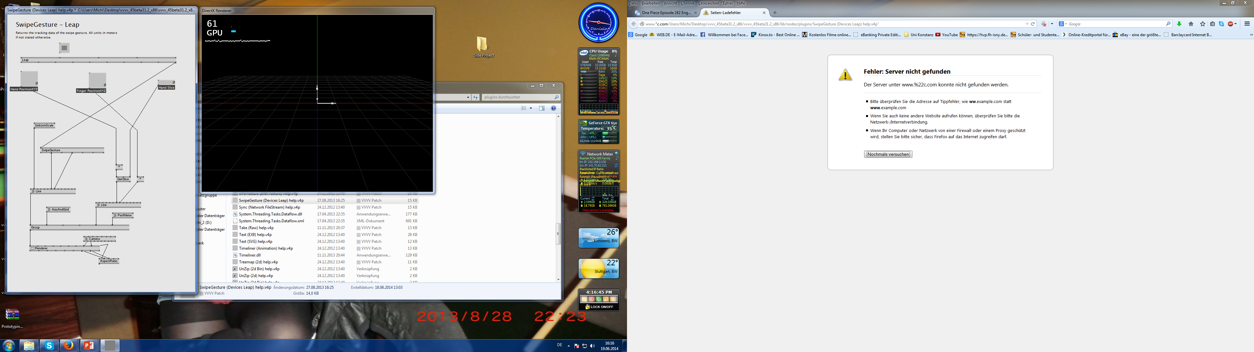
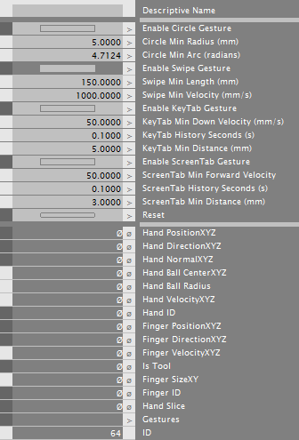
Leap motion in VVVV
Leap Node:

Slide 12
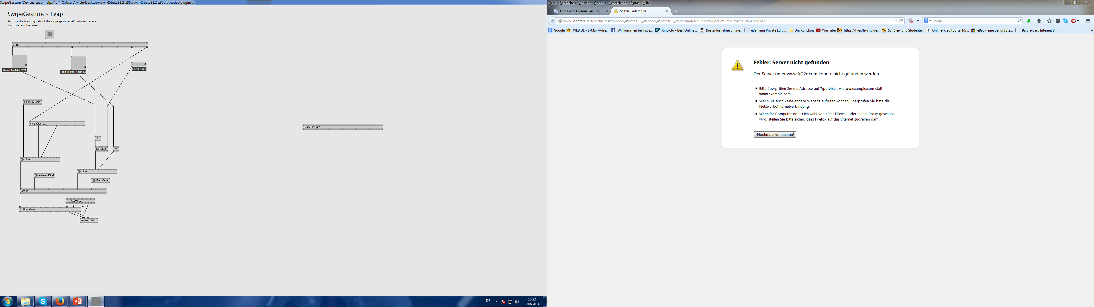
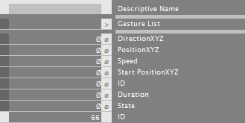
SwipeGesture Node:

Slide 13
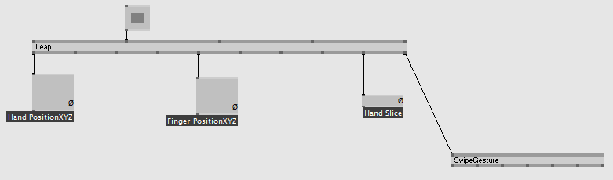
Together:

Slide 14
Leap Motion demo patch
Demo patch leap motion

Slide 15
Kinect vs. Leap Motion
Kinect: + Tracking of the whole body
        + The complete body as interface
        Not very exact measuring of single parts of the body
        Price more than two times higher than Leap Motion , ca. 200€
Leap M.: + Very exact Tracking of the Hand
        + Very easy to use and low price, ca. 90€
        + A certain amount of applications are existing for free use(kind
        of like App store)
        Not capable of measuring any other part of the body than the hand

Slide 16
The Kinect is good if you want to use your whole body as an interface. So far it is the only system for private use that is capable of Tracking the whole body.
The Leap Motion is very good for controlling for example the computer or the browser with hand gestures, because it has a quite exact recognition of the Hand. It also already has a good offer of different applications and games through the app store airspace.

Slide 17
Questions??

Slide 18
Sources
Prototyping interfaces: Interaktives skizzieren mit vvvv: Hermann Schmidt Mainz Verlag 2013
http://www.techopedia.com/definition/618/gesture-recognition
http://en.wikipedia.org/wiki/Gesture_recognition
http://www.gamingxp.com/newsview-25561-e3_2010_25_millionen_xbox_live_user_kinect_live_demo.htm
http://en.wikipedia.org/wiki/Leap_Motion

