Slide 1
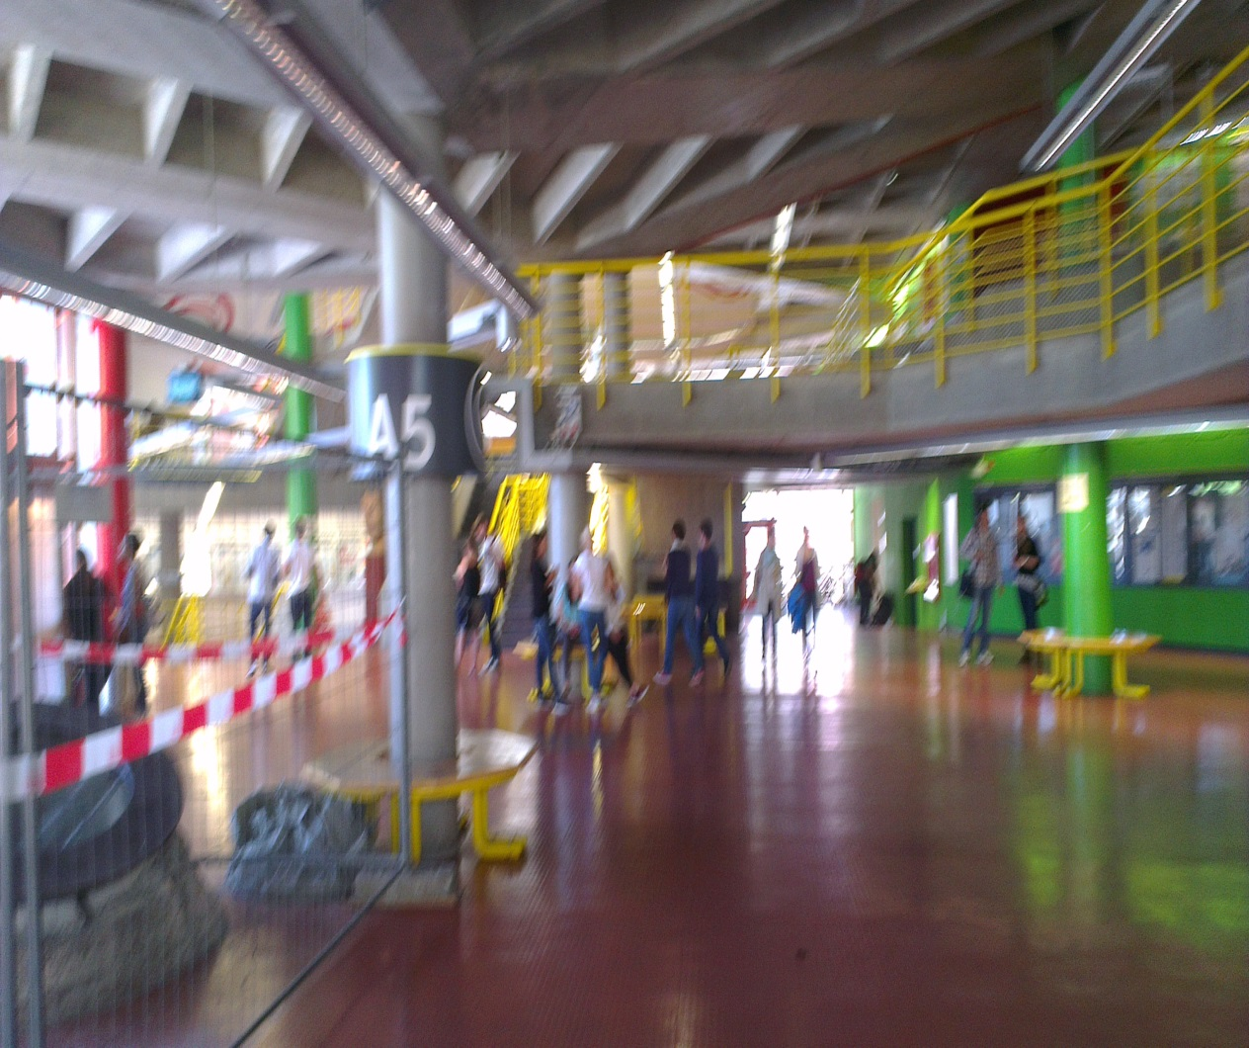
A5 at Uni Konstanz
Situation:
Using A5 for meeting freinds, setting there , chitchating with each other
Target Group:
Students who come there to meet their firneds or having a free slot and waiting for next lecture
Setting:
Like lobbies in companies where cleints wait , meet company employeses. Mostly public buildings.
Themes:
Interactive displays
Interacitve games
Lighting and temperature control.
Interactive activities.

Slide 2
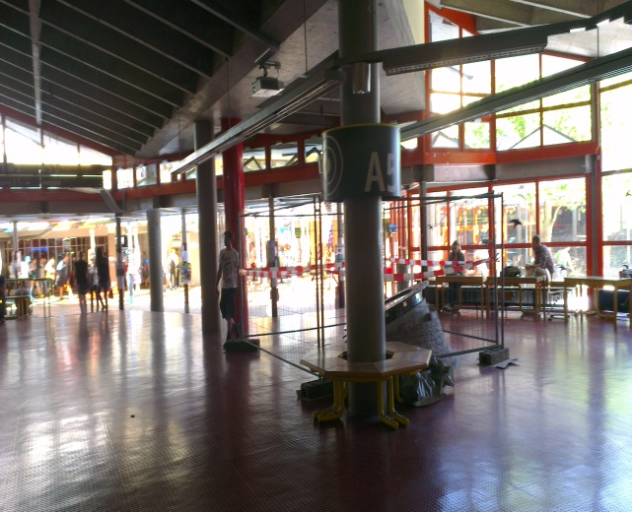
A5 at Uni Konstanz
A5 at uni Konstanz is somehow boring only got some benches to sit on. Sometimes people just go and sit there because they have free slots and they got nothing funny to do while sitting there.
Notes:

