Slide 1
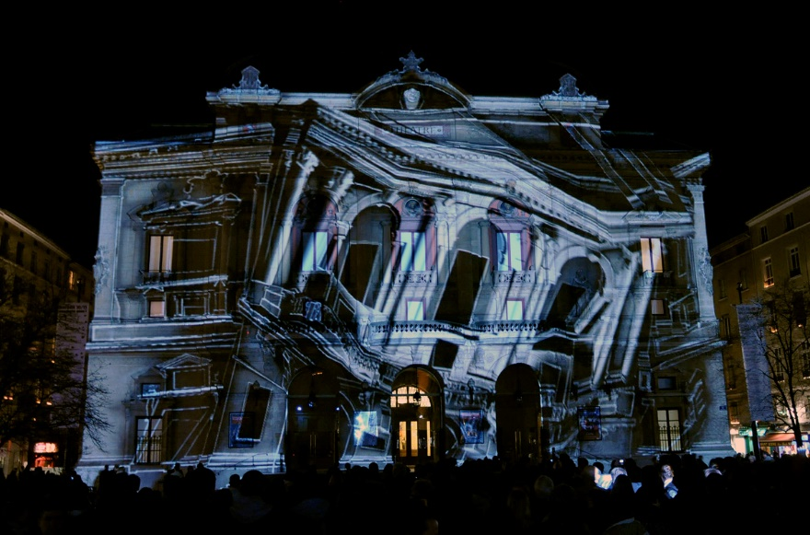
3D Projection Mapping
Introduction
History
Setup
VVVV
Video Example
http://wizardstudiosglobal.com/projection-mapping/

Slide 2
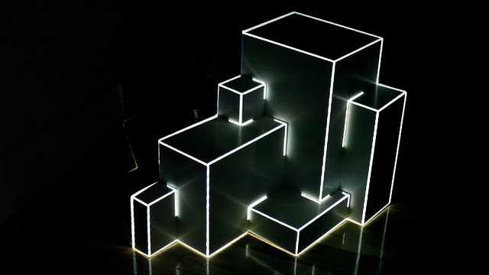
3D Projection Mapping
Introduction
Projection Mapping is used to create 3D Illusions on, mostly unregularly shaped, objects
This objects differ from small installations to complex industrial buildings
Mostly used for special occasions, festivals, openings, advertisements etc.
Visualization are based on different inputs: mainly sound and movement sensors
---

Slide 3
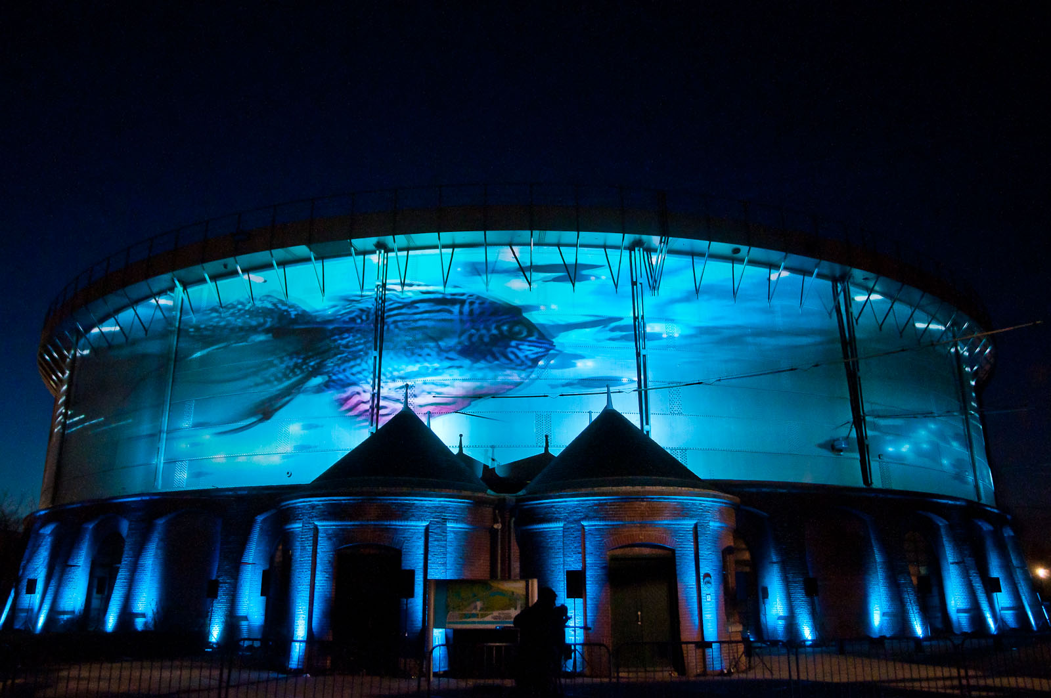
3D Projection Mapping
1. Introduction
Requirements:
  PC
  Beamer (at least one)
  Software (vvvv; vj-software etc.)
Additional requirements:
  Kinect, different Sensors
  Music Instruments (Midi Controller)
---

Slide 4
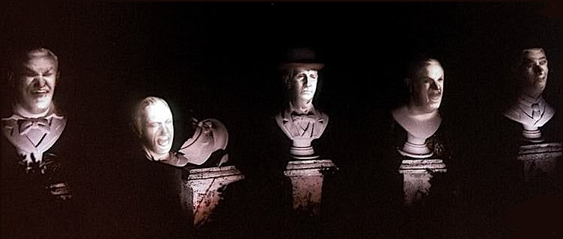
3D Projection Mapping
2. History
One of the first projections on non-flat surfaces is from 1969
Disney used the technique for some optical illusions
  for the opening of the Haunted Mansion ride in Disneyland
Singers were recorded and
the footage was projected
on the busts of their faces
http://projection-mapping.org/the-history-of-projection-mapping/

Slide 5
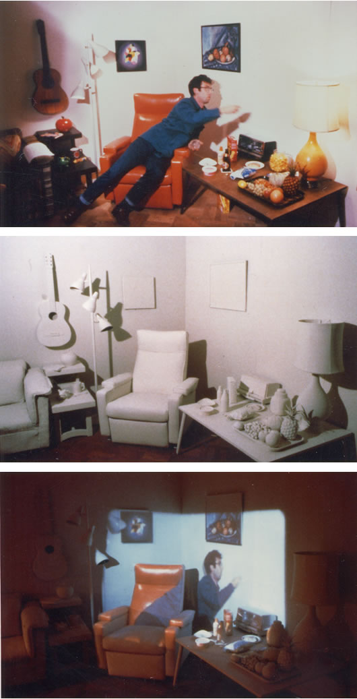
3D Projection Mapping
2. History
Another projection example of the 80s is from Michael Naimark
He recorded a room with two performers
The room was painted completely white
A projector displayed the recorded content
http://www.naimark.net/projects/displacements.html

Slide 6

3D Projection Mapping
2. History
http://projection-mapping.org/the-history-of-projection-mapping/

Slide 7
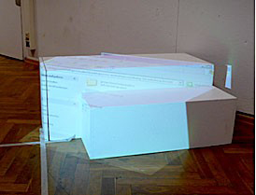
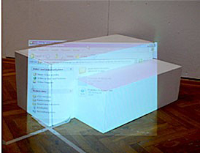
3D Projection Mapping
3. Setup
The main difficult in the beginning, is to find the right viewing position
The projection will look undistorted only from the view of the projector
So the projection needs to be adjusted to fit the real world shapes
http://vvvv.org/documentation/how-to-project-on-3d-geometry

Slide 8
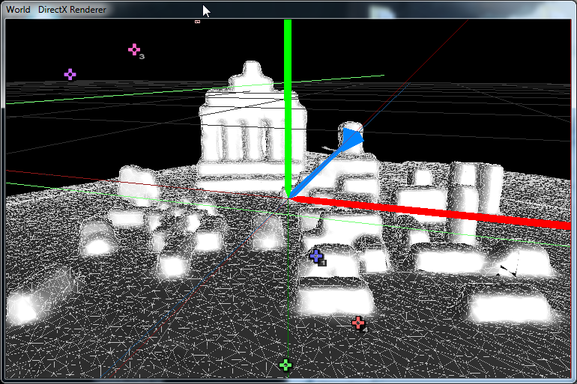
3D Projection Mapping
3. Setup
As next step, the environment should be rebuild as a virtual replica
It can be made either in vvvv with simple geometries or in other 3D software (e.g Blender)
This example was created with ReconstructMe (SDK for free available)
http://vvvv.org/contribution/vvvv.tutorials.mapping.3d

Slide 9
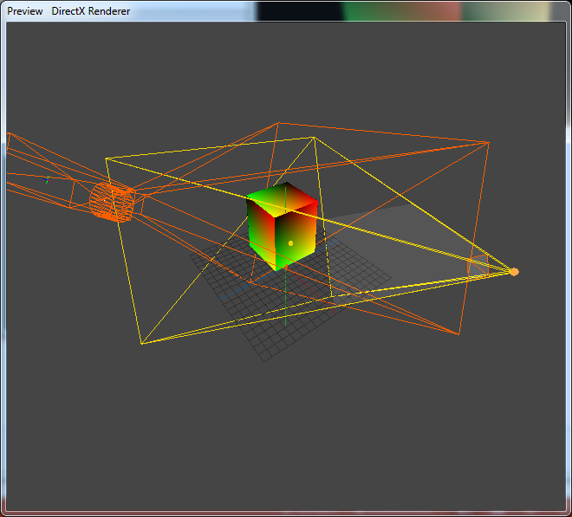
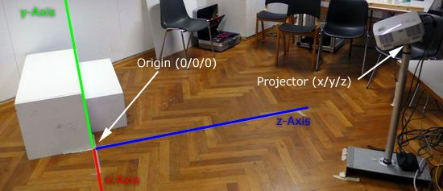
3D Projection Mapping
3. Setup
For the best result, the real coordinates must be implemented in the virtual scene with regarding to the projectors position, orientation and lens-characteristics
http://vvvv.org/documentation/how-to-project-on-3d-geometry

Slide 10
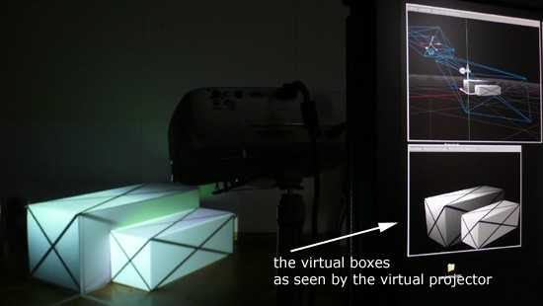
3D Projection Mapping
3. Setup
As last step, a texture or video can be mapped on the objects
Further, any kind of combinations with other devices, sensors, music are
possible
http://vvvv.org/documentation/how-to-project-on-3d-geometry

Slide 11
3D Projection Mapping
4. VVVV
---

Slide 12
3D Projection Mapping
5. Video Example
http://www.youtube.com/watch?v=UJ7E7uEZN00&feature=kp
http://www.youtube.com/watch?v=4iGNTegpLZI#t=137
---

