Slide 1
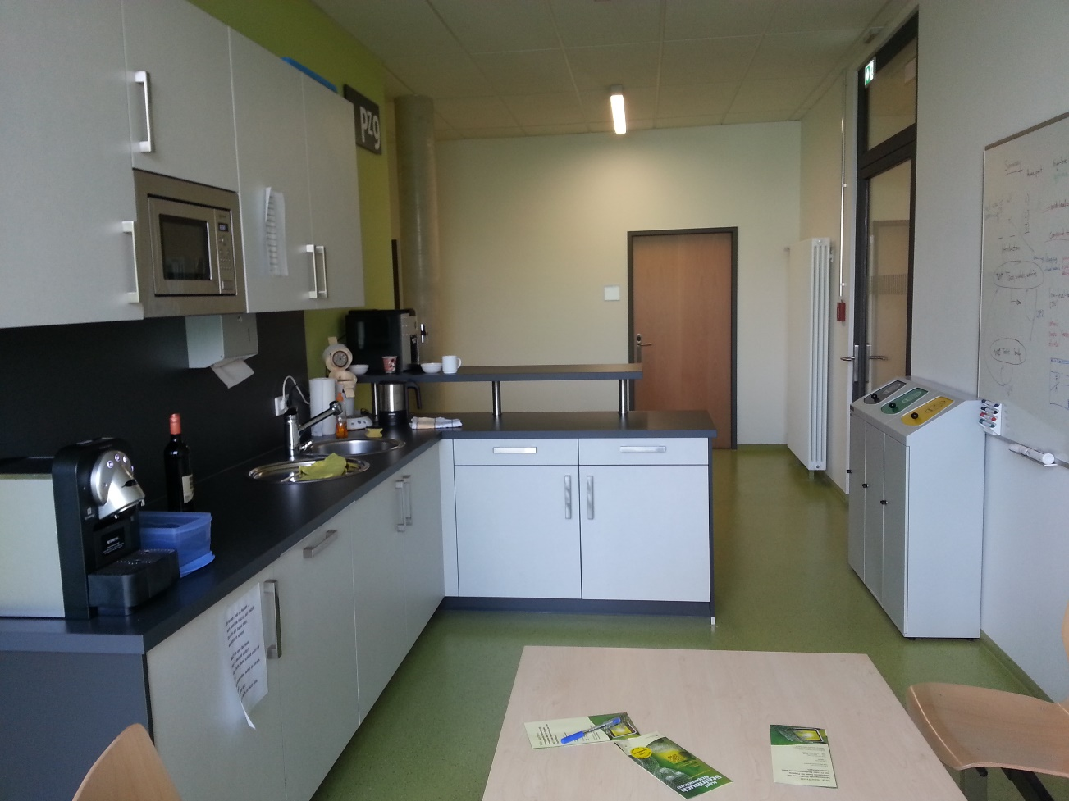
Community kitchen
Situation:
Everyday life on PZ9, a kitchen, some electric devices, many users, mostly short time user
Target Group:
Residents of PZ9, learning groups, passerbys
Setting:
Typical community kitchen, much space for creativity
Themes:
Remote communities
Coffee counting
How often is what used
Behavior of users

Slide 2

Community kitchen
On PZ9 is a community kitchen which is used by resident people of the HCI group, software engineering group and students. We have a coffee machine, dishwasher and microwave. The whiteboard and desk is used for meetings or by learning groups.
Notes:

